Slide 1

Autistic Spectrum Condition (ASC) Parental ‘Hot Spot’

Slide 2
The SEND team here at Yardleys:
Mrs Begum
Ms Bhambra
Ms Bondos
Ms Chowdhury
Mrs Crew – HLTA 4
Ms Kauser
Mrs Morris
Agency TA’s – Anjum Ahmed ; Ilsa Mehmood
Ms Wareham – Administrator
Mr Thornton – SENCo
SLT Lead – Ms Yates

Slide 3
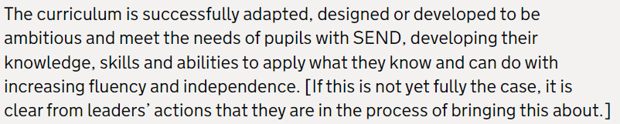
Curriculum Intent - SEND

Slide 4
Yardleys SEND Vision
Our vision is that regardless of need or disability all students at Yardleys School receive a high-quality and ambitious education. Students with special educational needs and/or disabilities will have their needs identified and supported throughout their time here at Yardleys to ensure they receive an inclusive learning provision. This support will have a positive impact on their overall academic and holistic progress, allowing them to grow as individuals similar to students without special educational needs and/or disabilities.
As a result of the provision provided by the school, students with special educational needs and/or disabilities can fluently access the skills they need to become independent learners and thinkers throughout their lives, allowing them to accomplish their dreams and live their lives to the fullest.
Here at Yardleys School we achieve our vision by:
- Supporting the students identified as SEND as efficiently as possible through deploying resources effectively from their initial transition all the way to their progression into Post-16 provision. This enables them to successfully engage in, not only teaching and learning, but also in areas of the wider curriculum such as extracurricular activities, enrichment, student leadership and Personal Development.
- Working collaboratively with teaching staff, outside agencies, parents and students so that we can maximise the outcome for students with special educational needs and/or disabilities.
- Developing staff and student awareness, understanding and empathy towards our students with special educational needs and/or disabilities to ensure we continue to foster an inclusive environment where all can thrive.

Slide 5
What is autism?
Autism is a developmental condition that encompasses a range or spectrum of different experiences and presentations. Autism can vary from affecting social development and communication abilities to influencing a person’s interests, behaviours and responses to sensory stimuli. As a spectrum condition, there is not one single set of experiences, and every Autistic person will share some traits with others on the spectrum but also have their own individual traits – everyone on the spectrum is therefore different.

Slide 6
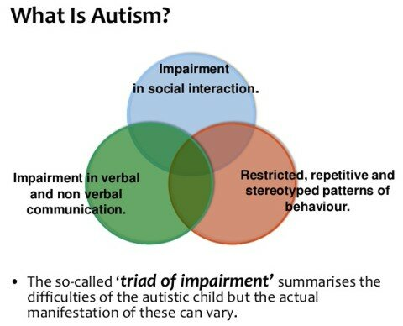
The Triad of Impairment

Slide 7
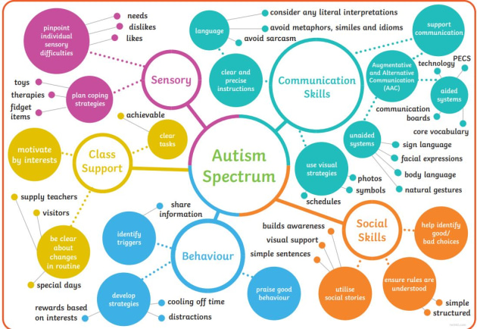
The Autistic Spectrum - characteristics

Slide 8
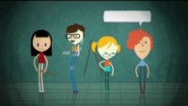

Slide 9
Reasonable Adjustments
An education provider has a duty to make ‘reasonable adjustments’ to make sure disabled students are not discriminated against. These changes could include providing extra support and aids (like specialist teachers or equipment), or a teacher not shouting at a disabled student for not paying attention when the student’s disability stops them from easily concentrating.

Slide 10
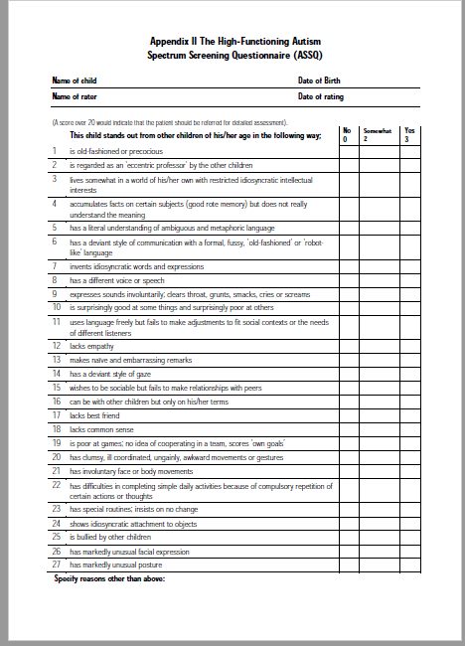
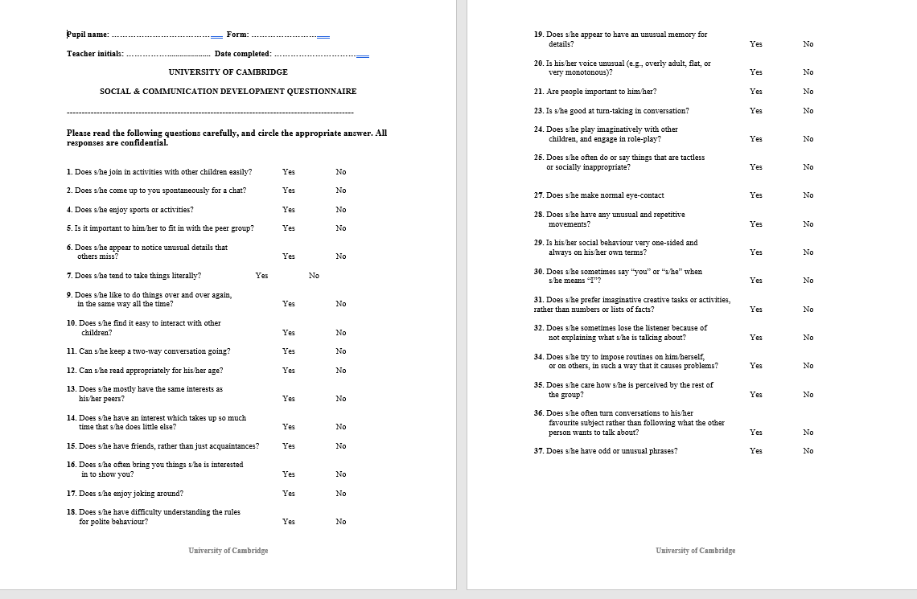
ASC – In school testing in support of outside agencies/ paediatricians – ASSQ and CAST
ASSQ – Autism Spectrum Screening Questionnaire
CAST – University of Cambridge Social & Communication Development Questionnaire

Slide 11
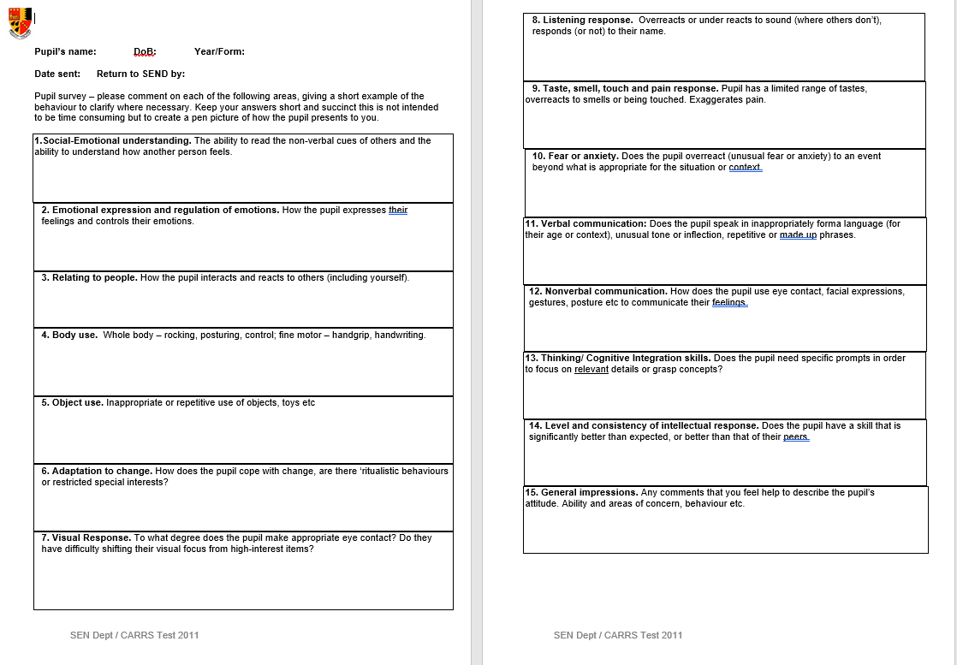
ASC – In school testing in support of outside agencies/ paediatricians - CARS
CARS – Childhood Autism Rating Scale

Slide 12
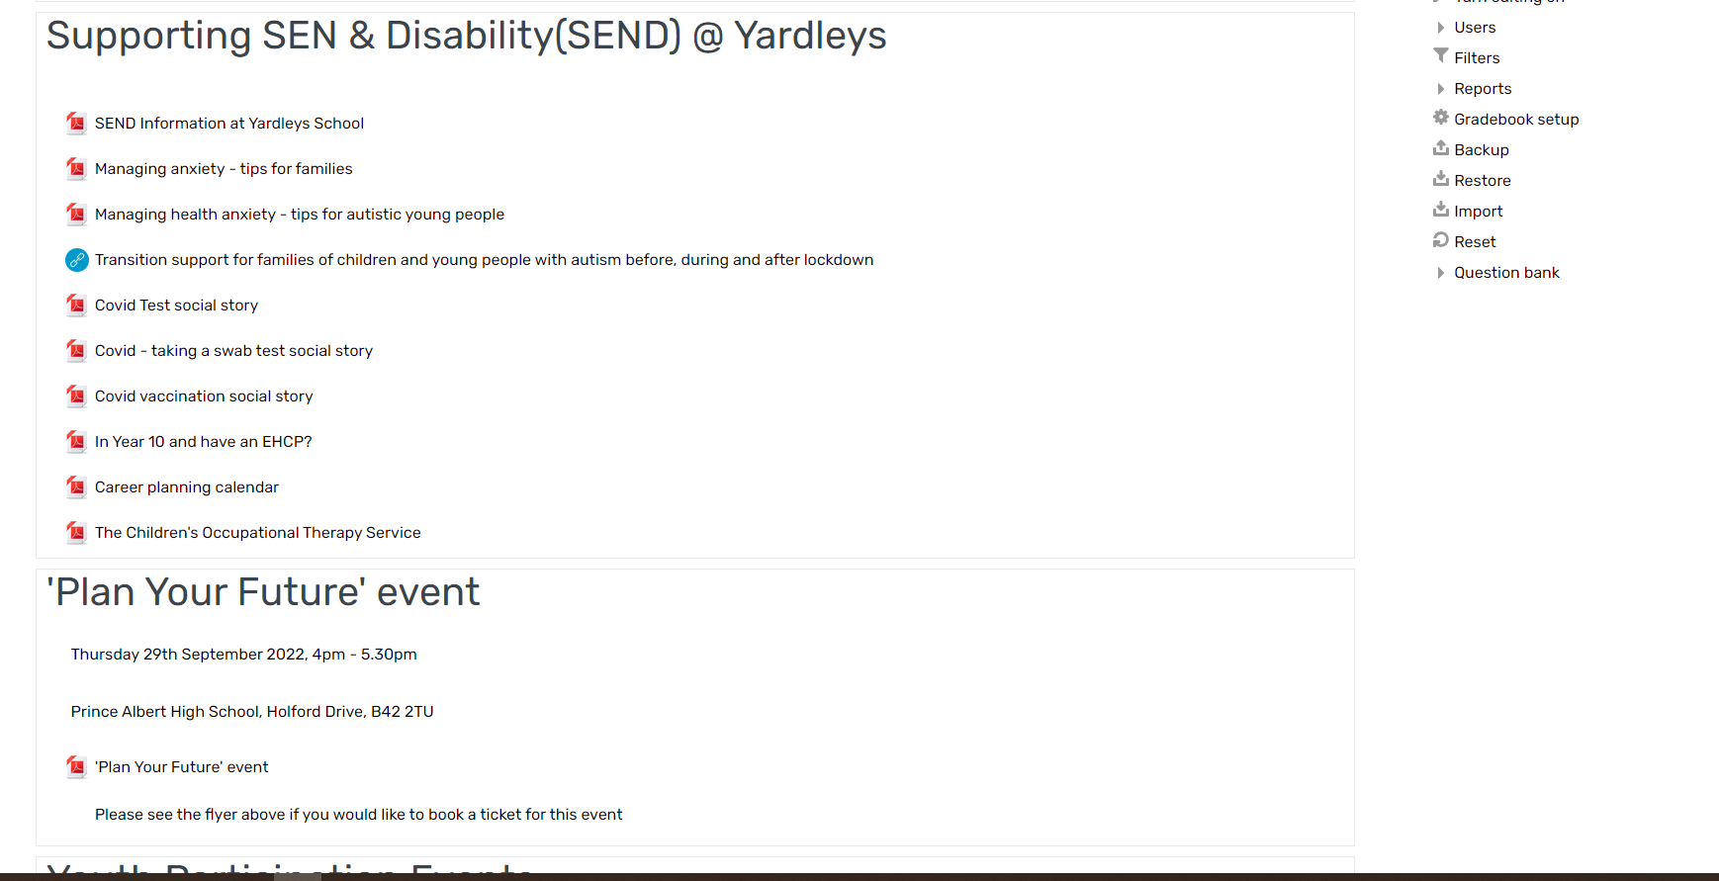
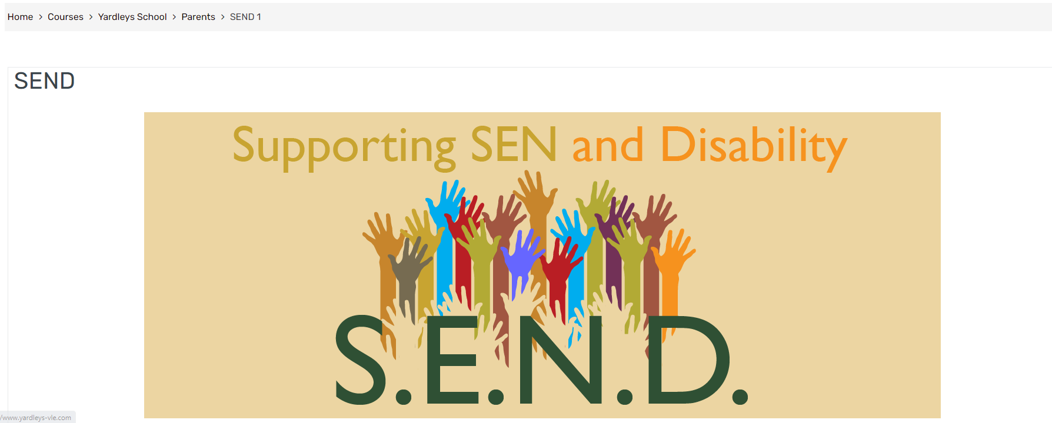
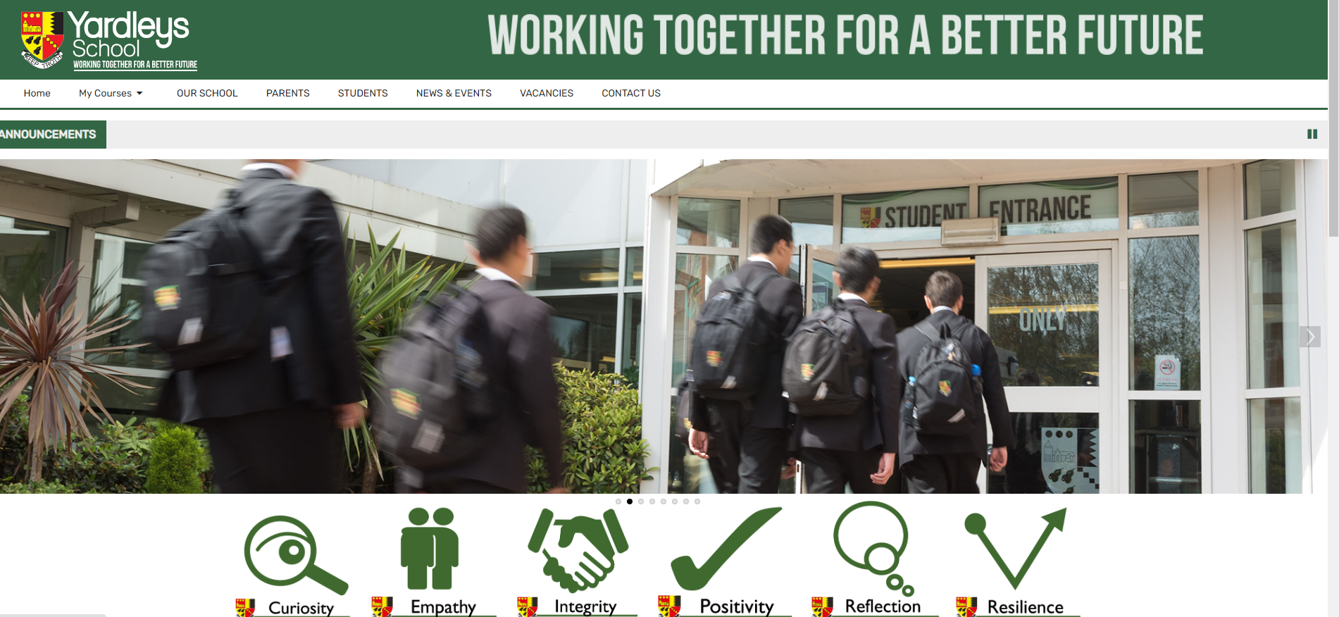
SEND – Parental information

Slide 13

Questions and time to share experiences

