Slide 1

Attention Deficit/ Hyperactive Disorder(ADHD) Hot Spot

Slide 2
The SEND team here at Yardleys:
Mrs Begum
Ms Bhambra
Ms Bondos
Ms Chowdhury
Mrs Crew – HLTA 4
Ms Kauser
Mrs Morris
Agency TA’s – Anjum Ahmed ; Ilsa Mehmood
Ms Wareham – Administrator
Mr Thornton – SENCo
SLT Lead – Ms Yates

Slide 3
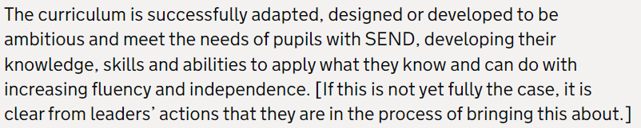
Curriculum Intent - SEND

Slide 4
Yardleys SEND Vision
Our vision is that regardless of need or disability all students at Yardleys School receive a high-quality and ambitious education. Students with special educational needs and/or disabilities will have their needs identified and supported throughout their time here at Yardleys to ensure they receive an inclusive learning provision. This support will have a positive impact on their overall academic and holistic progress, allowing them to grow as individuals similar to students without special educational needs and/or disabilities.
As a result of the provision provided by the school, students with special educational needs and/or disabilities can fluently access the skills they need to become independent learners and thinkers throughout their lives, allowing them to accomplish their dreams and live their lives to the fullest.
Here at Yardleys School we achieve our vision by:
- Supporting the students identified as SEND as efficiently as possible through deploying resources effectively from their initial transition all the way to their progression into Post-16 provision. This enables them to successfully engage in, not only teaching and learning, but also in areas of the wider curriculum such as extracurricular activities, enrichment, student leadership and Personal Development.
- Working collaboratively with teaching staff, outside agencies, parents and students so that we can maximise the outcome for students with special educational needs and/or disabilities.
- Developing staff and student awareness, understanding and empathy towards our students with special educational needs and/or disabilities to ensure we continue to foster an inclusive environment where all can thrive.

Slide 5
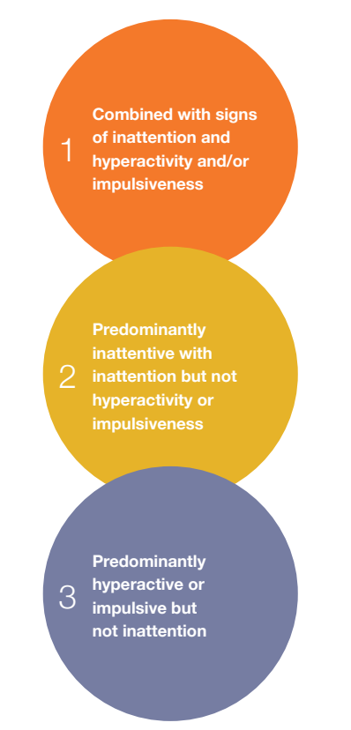
ADHD is:
defined by the ‘core’ signs of inattention, hyperactivity and impulsiveness, and there are three presentations:
Most children have this one

Slide 6
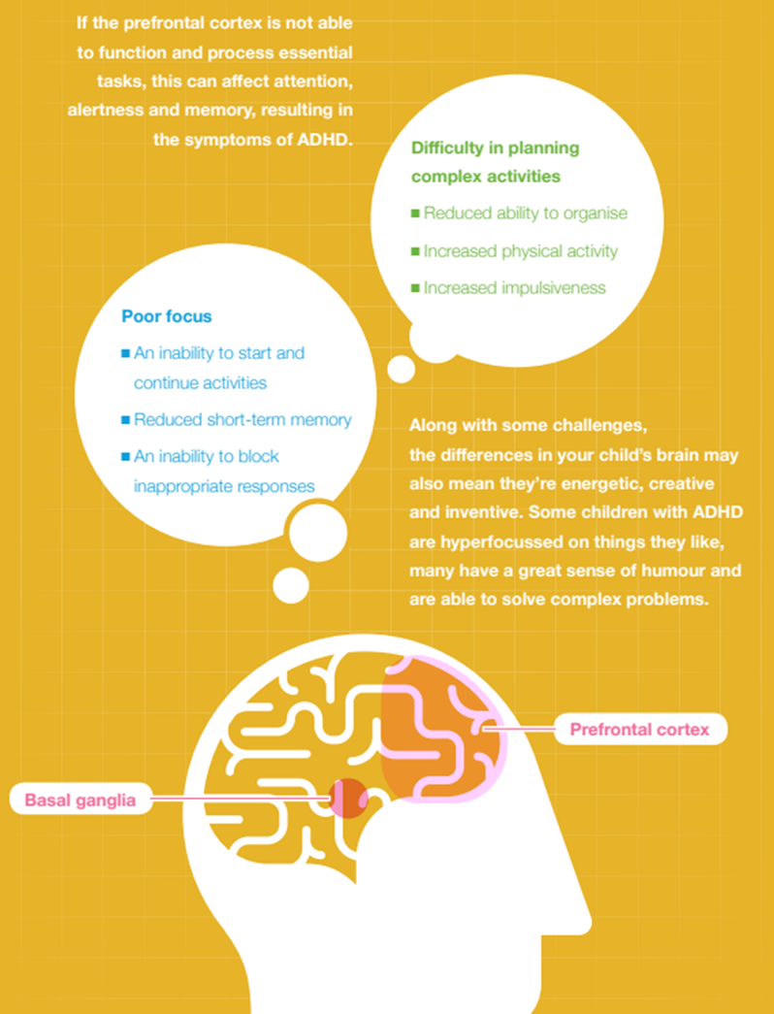
What causes ADHD?
In children with ADHD, the prefrontal cortex and the basal ganglia in the brain, along with certain other areas, are different from those without ADHD. Two chemical messengers or neurotransmitters - noradrenaline and dopamine - normally connect the prefrontal cortex and the basal ganglia. Lower levels of these messengers result in poor connections between these areas leading to the altered brain functioning found in people with ADHD.
So your child isn’t ‘naughty’ or badly behaved: their brain differences mean that they genuinely struggle with certain tasks:
The prefrontal cortex is responsible for planning, starting and carrying out actions as well as correcting errors, avoiding distractions and being flexible when needed.
The basal ganglia is responsible for impulse control. It coordinates information coming from other regions of the brain to avoid automatic responses to stimuli, such as loud noises.

Slide 7
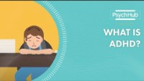

Slide 8
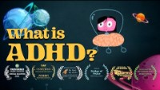

Slide 9
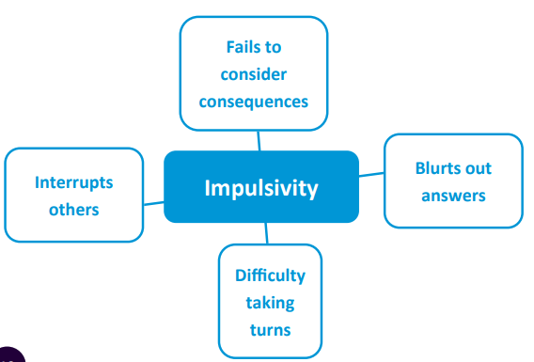
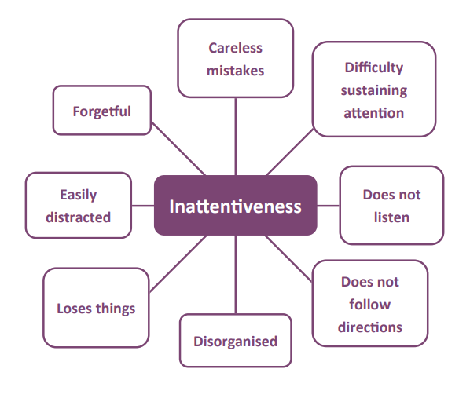
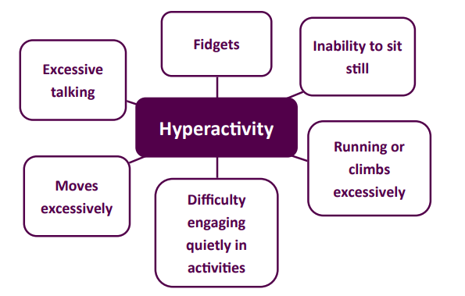
Characteristics of ADHD

Slide 10
Medication for ADHD
Medication used for the treatment of ADHD:
Methylphenidate – most common. It belongs to a group of medicines called stimulants, which work by increasing activity in the brain, particularly in areas that play a part in controlling attention and behaviour.
Lisdexamfetamine - a medicine that stimulates certain parts of the brain. It improves concentration, helps focus attention and reduces impulsive behaviour.
Dexamfetamine - similar to Lisdexamfetamine and works in the same way.
Atomoxetine - works differently from other ADHD medicines. It's a selective noradrenaline reuptake inhibitor (SNRI), which means it increases the amount of a chemical in the brain called noradrenaline. This chemical passes messages between brain cells, and increasing it can aid concentration and help control impulses.
Guanfacine - acts on part of the brain to improve attention, and it also reduces blood pressure.
Although these medications are not a cure for ADHD, they may help people with ADHD to concentrate better, be less impulsive, feel calmer, and learn and practice new skills.
https://www.nhs.uk/conditions/attention-deficit-hyperactivity-disorder-adhd/treatment/

Slide 11
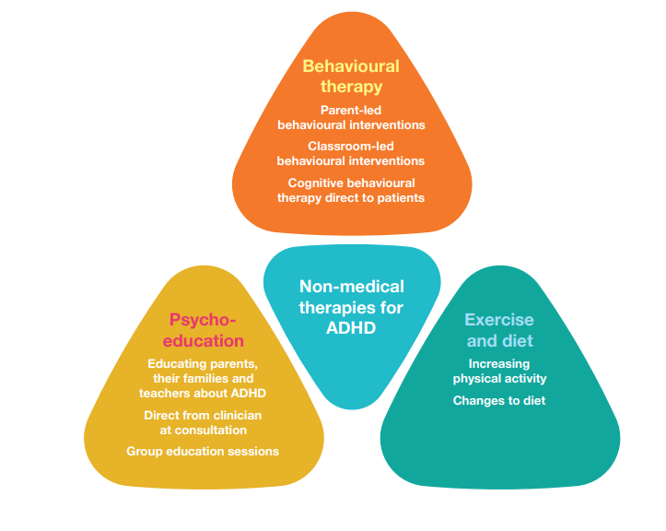
Other treatments for ADHD

Slide 12
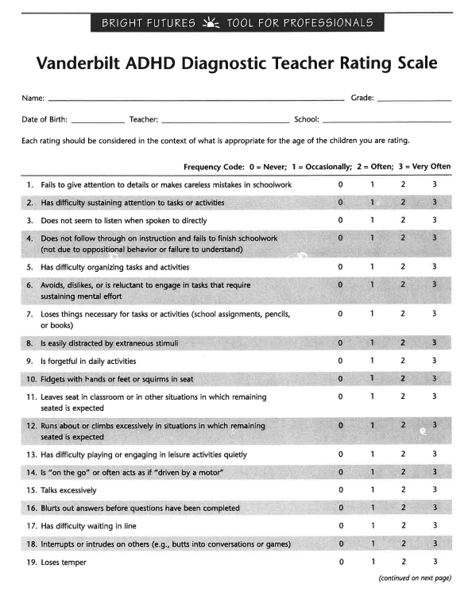
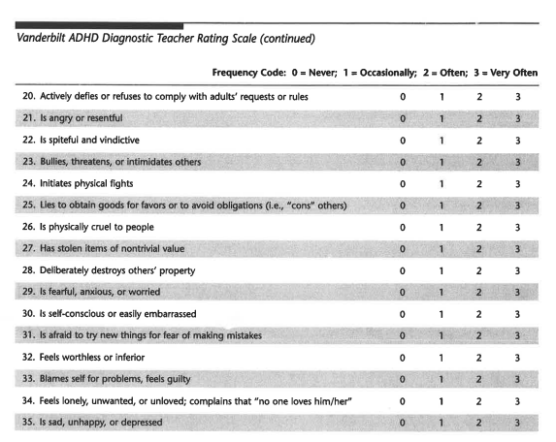
ADHD – In school testing - Vanderbilt

Slide 13
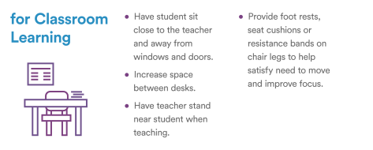

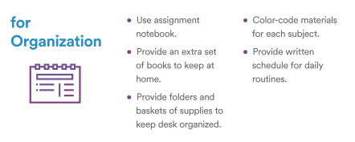
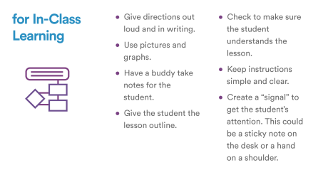
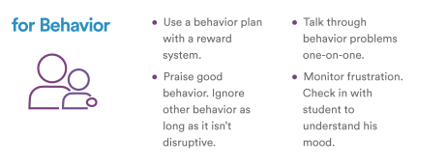
Classroom accommodations to help students with ADHD

Slide 14
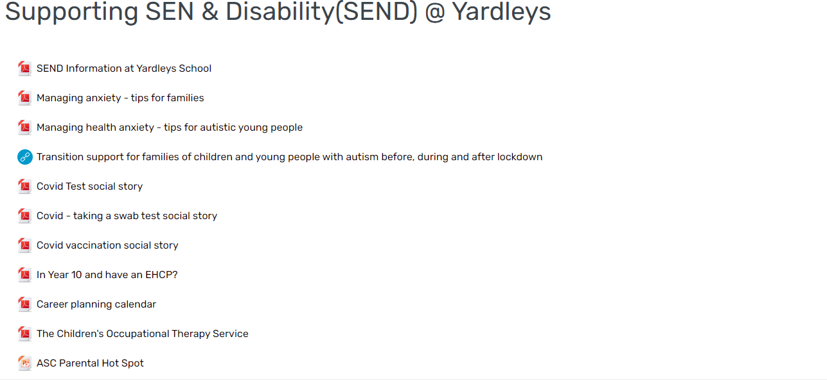


SEND – Parental information

Slide 15

Questions and time to share experiences

