Slide 1
Moderate Learning Difficulties (MLD) Hot Spot KS3

Slide 2
The SEND team here at Yardleys:
Mrs Begum
Ms Bhambra
Ms Bondos
Ms Chowdhury
Mrs Crew – HLTA 4
Ms Hackett
Ms Kauser
Ms Mitchell
Mrs Morris
Ms Wareham – Administrator
Mr Thornton - SENCo

Slide 3
Curriculum Intent - SEND
The curriculum is successfully adapted, designed or developed to be ambitious and meet the needs of pupils with SEND, developing their knowledge, skills and abilities to apply what they know and can do withy increasing fluency and independence.

Slide 4
Yardleys SEND Vision
Our vision is that regardless of need or disability all students at Yardleys School receive a high-quality and ambitious education. Students with special educational needs and/or disabilities will have their needs identified and supported throughout their time here at Yardleys to ensure they receive an inclusive learning provision. This support will have a positive impact on their overall academic and holistic progress, allowing them to grow as individuals similar to students without special educational needs and/or disabilities.
As a result of the provision provided by the school, students with special educational needs and/or disabilities can fluently access the skills they need to become independent learners and thinkers throughout their lives, allowing them to accomplish their dreams and live their lives to the fullest.
Here at Yardleys School we achieve our vision by:
- Supporting the students identified as SEND as efficiently as possible through deploying resources effectively from their initial transition all the way to their progression into Post-16 provision. This enables them to successfully engage in, not only teaching and learning, but also in areas of the wider curriculum such as extracurricular activities, enrichment, student leadership and Personal Development.
- Working collaboratively with teaching staff, outside agencies, parents and students so that we can maximise the outcome for students with special educational needs and/or disabilities.
- Developing staff and student awareness, understanding and empathy towards our students with special educational needs and/or disabilities to ensure we continue to foster an inclusive environment where all can thrive.

Slide 5
MLD – Moderate Learning Difficulties
Norwich and Ylonen (2013) argue that the most disputed and under researched area of special educational needs is that of moderate learning difficulties (MLD), even though it is identified as the most significant need within most schools (Hatton, Emerson, 2016). On the Code of Practice at present within Yardleys, 62 pupils are identified with MLD as their primary need, however a further 14 are identified with it as their secondary one, identifying 76 pupils with MLD out of a total of 165 on the code, approximately 46%.

Slide 6
What are moderate learning difficulties (MLD)?
A pupil identified as having MLD, will according to the Department for Education definition:
‘…have attainments significantly below expected levels in most areas of the curriculum,..’ and will ‘…have much greater difficulty than their peers in acquiring basic literacy and numeracy skills and in understanding concepts. They may also have associated speech and language delay, low self-esteem, low levels of concentration and under-developed social skills.’ (DfES, 2005:3)

Slide 7
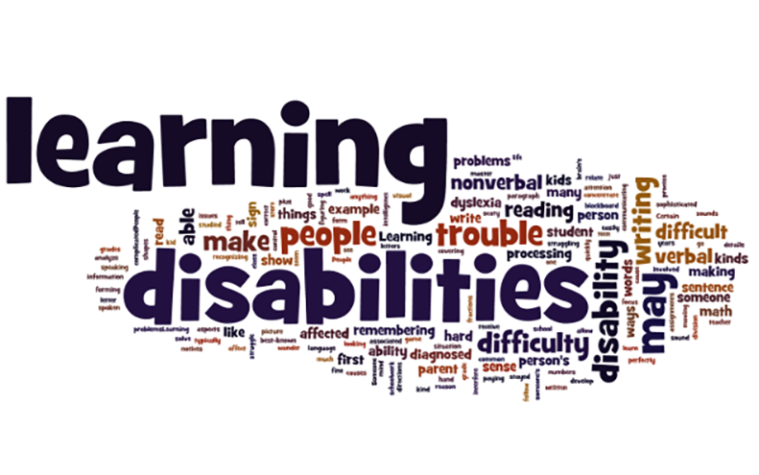

Slide 8
MLD – Moderate Learning Difficulties
Processing is a significant need associated with MLD pupils. Processing is directly related to working memory, which to put it simply, is ‘a mental workspace that we can use to store important information in the course of our mental activities’. Many other learning tasks within school also place a strain upon working memory, such as copying off the whiteboard or listening to and then following a set of verbal instructions, causing a pupil with MLD significant difficulties.

Slide 9
Cognitive Load

Slide 10
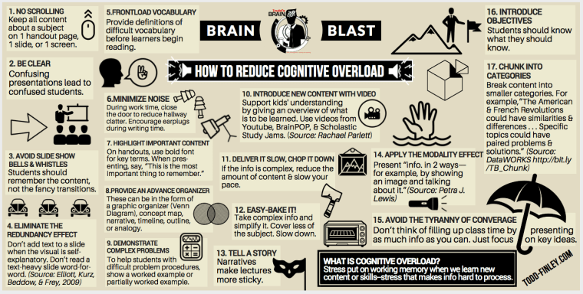
Reducing cognitive overload

Slide 11
MLD – Moderate Learning Difficulties
Interventions and strategies that can be implemented to support teaching and learning include:
1. over-learning to imbed key points
2. scaffolding tasks to allow appropriate access
3.to revise and review prior learning more regularly, as they may not retain it, even from the previous lesson
4.not assuming that because it’s easy for us, that it will be accessible to them.

Slide 12
MLD – Moderate Learning Difficulties
The problem we have as teachers is deciding which strategies to use in order to meet the needs of the MLD pupils, because one type will not suit all. My best advice is to use several throughout the lesson:
Do-Now - quiz could include sentence starters and/or keywords. Remember allow additional time for processing. Try not to have too many questions or too big a task, as it will take too long to complete.

Slide 13
MLD – Moderate Learning Difficulties
Main lesson activities need to be short, repetitive and varied in order to build upon the knowledge or thing you want them to learn. A visual activity, followed by a short written activity, followed by a simple plenary to consolidate what has been learnt.
All printed resources and materials need to be in 14 point font and a friendly text format, such as Comic Sans or Berlin Sans.

Slide 14
What were the 4 symptoms of the Black Death
Label the outline with the symptoms of the Black Death.

Slide 15
Show your understanding: The Black Death
What were the 4 symptoms of the Black Death
The four symptoms of the Black Death were:
buboes
fever and vomiting
black/ blue blotches
seizures/ shivers & shakes
Notes:
Comprehension questions

Slide 16
SEND – Parental information

Slide 17
Questions and time to share experiences

