Slide 1

Moderate Learning Difficulties (MLD) & Specific Learning Difficulties (SpLD)
Hot Spot

Slide 2
The SEND team here at Yardleys:
Ms Ahmed
Mrs Begum
Ms Bhambra
Ms Bondos
Ms Chowdhury
Mrs Crew – HLTA 4
Ms Kauser
Mrs Morris
Ms Smith
Agency TA’s – Anjum Ahmed ; Ilsa Mehmood
Ms Wareham – Administrator
Mr Thornton – SENCo
SLT Lead – Ms Yates

Slide 3
Curriculum Intent - SEND
The curriculum is successfully adapted, designed or developed to be ambitious and meet the needs of pupils with SEND, developing their knowledge, skills and abilities to apply what they know and can do withy increasing fluency and independence.

Slide 4
Yardleys SEND Vision
Our vision is that regardless of need or disability all students at Yardleys School receive a high-quality and ambitious education. Students with special educational needs and/or disabilities will have their needs identified and supported throughout their time here at Yardleys to ensure they receive an inclusive learning provision. This support will have a positive impact on their overall academic and holistic progress, allowing them to grow as individuals similar to students without special educational needs and/or disabilities.
As a result of the provision provided by the school, students with special educational needs and/or disabilities can fluently access the skills they need to become independent learners and thinkers throughout their lives, allowing them to accomplish their dreams and live their lives to the fullest.
Here at Yardleys School we achieve our vision by:
- Supporting the students identified as SEND as efficiently as possible through deploying resources effectively from their initial transition all the way to their progression into Post-16 provision. This enables them to successfully engage in, not only teaching and learning, but also in areas of the wider curriculum such as extracurricular activities, enrichment, student leadership and Personal Development.
- Working collaboratively with teaching staff, outside agencies, parents and students so that we can maximise the outcome for students with special educational needs and/or disabilities.
- Developing staff and student awareness, understanding and empathy towards our students with special educational needs and/or disabilities to ensure we continue to foster an inclusive environment where all can thrive.

Slide 5
What are moderate learning difficulties (MLD)?
A pupil identified as having MLD, will according to the Department for Education definition:
‘…have attainments significantly below expected levels in most areas of the curriculum,..’ and will ‘…have much greater difficulty than their peers in acquiring basic literacy and numeracy skills and in understanding concepts. They may also have associated speech and language delay, low self-esteem, low levels of concentration and under-developed social skills.’ (DfES, 2005:3)

Slide 6
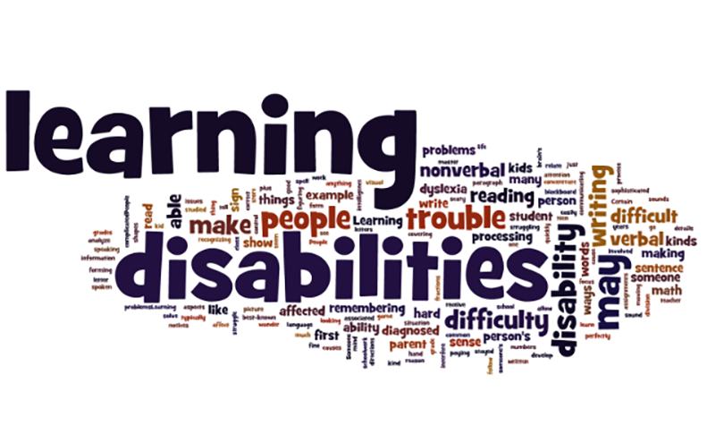

Slide 7
MLD – Moderate Learning Difficulties
Processing is a significant need associated with MLD pupils. Processing is directly related to working memory, which to put it simply, is ‘a mental workspace that we can use to store important information in the course of our mental activities’. Many other learning tasks within school also place a strain upon working memory, such as copying off the whiteboard or listening to and then following a set of verbal instructions, causing a pupil with MLD significant difficulties.

Slide 8
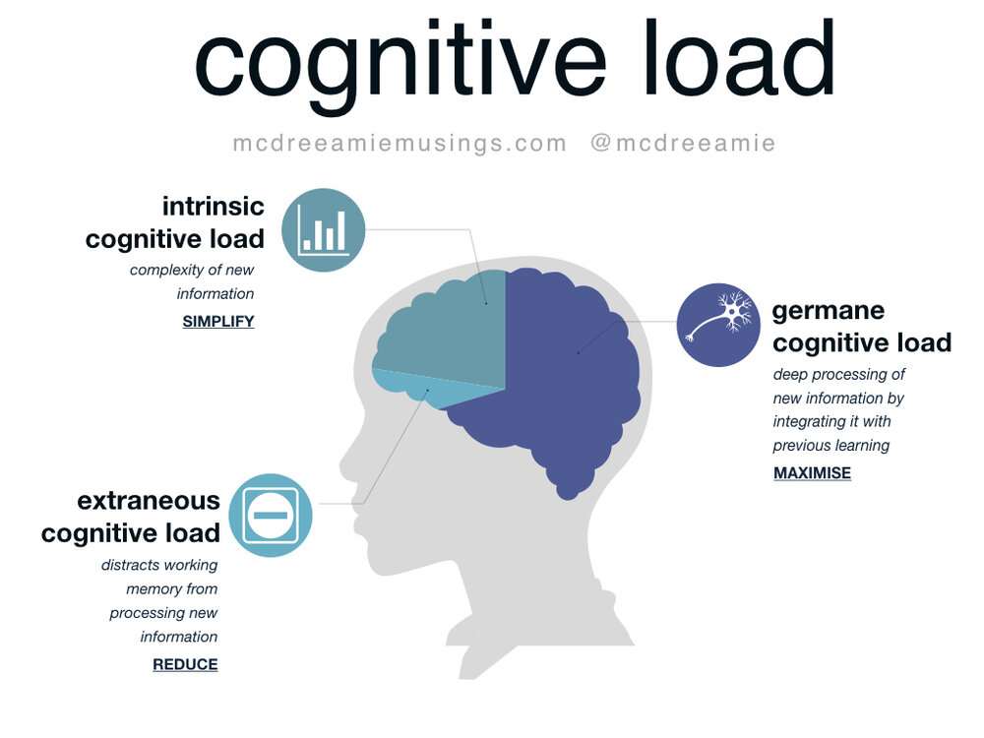
Cognitive Load

Slide 9
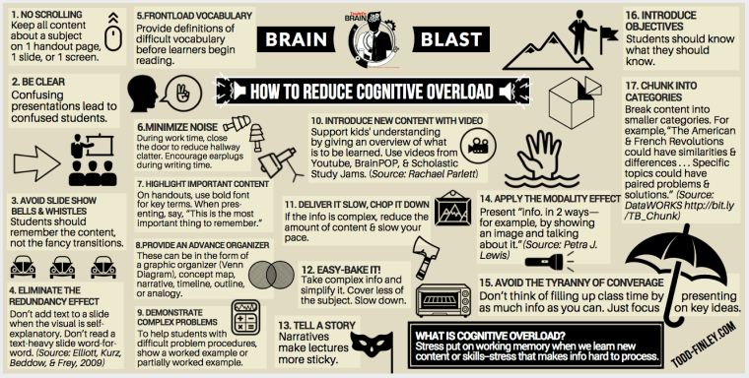
Reducing cognitive overload

Slide 10
MLD – Moderate Learning Difficulties
Interventions and strategies that can be implemented to support teaching and learning include:
1. over-learning to imbed key points
2. scaffolding tasks to allow appropriate access
3.to revise and review prior learning more regularly, as they may not retain it, even from the previous lesson
4.not assuming that because it’s easy for us, that it will be accessible to them.

Slide 11
MLD – Moderate Learning Difficulties
The problem we have as teachers is deciding which strategies to use in order to meet the needs of the MLD pupils, because one type will not suit all. My best advice is to use several throughout the lesson:
Do-Now - quiz could include sentence starters and/or keywords. Remember allow additional time for processing. Try not to have too many questions or too big a task, as it will take too long to complete.

Slide 12
MLD – Moderate Learning Difficulties
Main lesson activities need to be short, repetitive and varied in order to build upon the knowledge or thing you want them to learn. A visual activity, followed by a short written activity, followed by a simple plenary to consolidate what has been learnt.
All printed resources and materials need to be in 14 point font and a friendly text format, such as Comic Sans or Berlin Sans.

Slide 13
MLD – Moderate Learning Difficulties
Revision and exams
Pupils identified with MLD may find revision difficult, especially when it comes to remembering content, which methods to use and most importantly, for how long!
Short 30 minute sessions are best, as this allows the brain to take on board what has been revised. Then have a break, and go and do something else, including helping out with chores, relaxing, watching T.V., a walk or playing a game. Then choose a different subject and revise for another 30 minutes, again followed by a break, before beginning revision again.
What is revision?
Going through the work in your book to learn it for a test.

Slide 14
THREE ways to revise:
Keywords – using a highlighter, find keywords and write down what they mean.
Flashcards – use flashcards to write down facts and then learn them. Use 1 flashcard for each fact.
Visual mind maps – use pictures to help you learn and remember information.

Slide 15

Keywords
Why is revision important?
To understand the topics in the exam being taken.
Meaning – the subject you are learning about

Slide 16
Flashcards
Who were the THREE contenders for the English throne in 1066?
Harold Godwinson
William of Normandy
Harald Hardrada

Slide 17
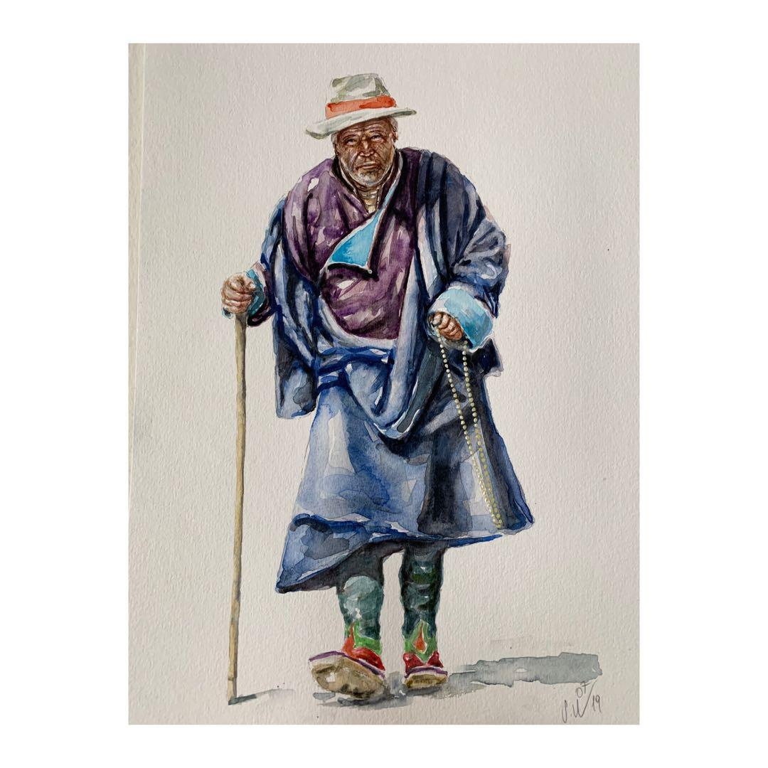

Visual mind map:
What 4 things did Siddhartha see when he left the palace?

Slide 18
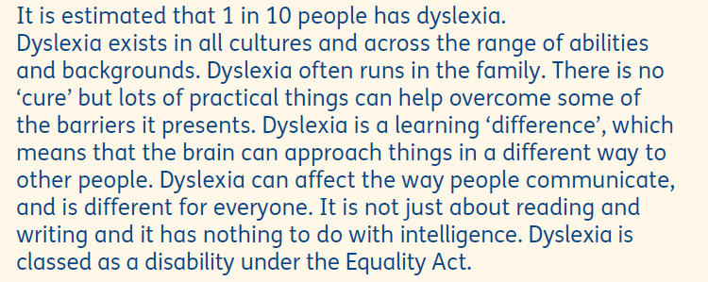
What is dyslexia?

Slide 19
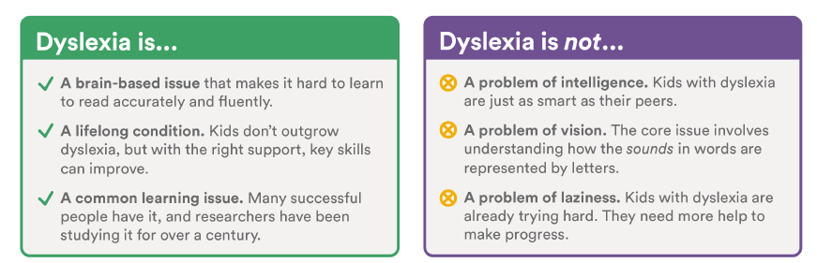
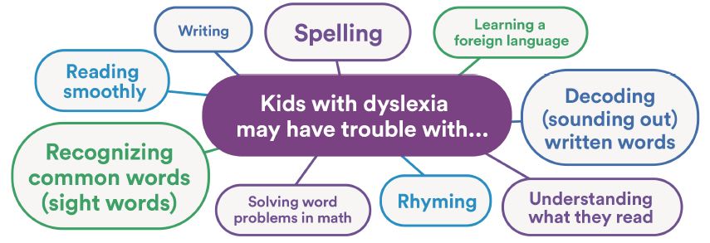
Dyslexia

Slide 20
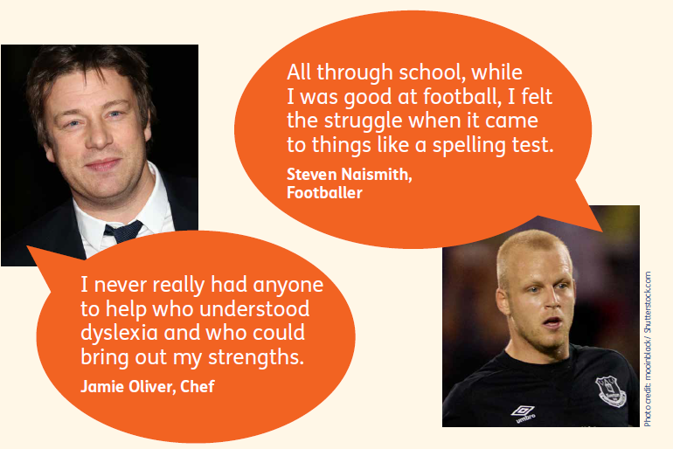
Famous people who are dyslexic

Slide 21

Famous people who are dyslexic

Slide 22
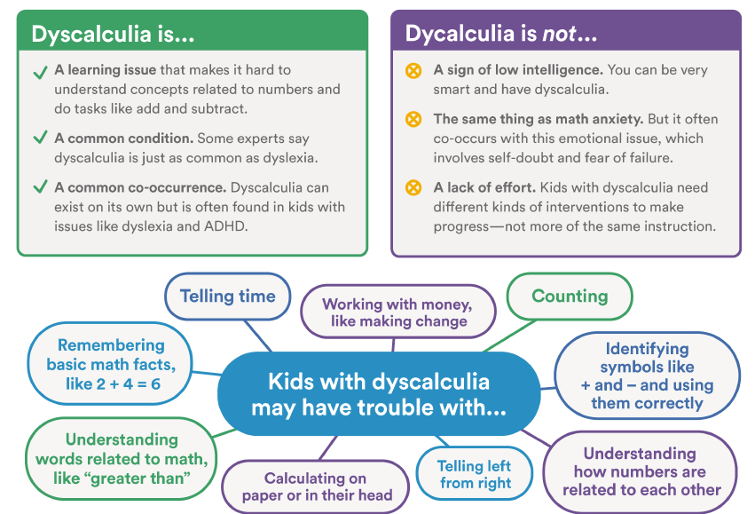
Dyscalculia

Slide 23
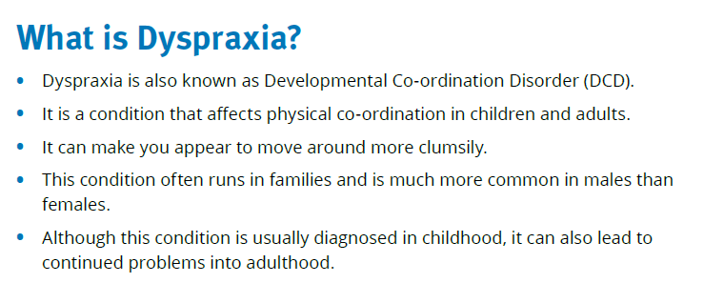
Dyspraxia

Slide 24
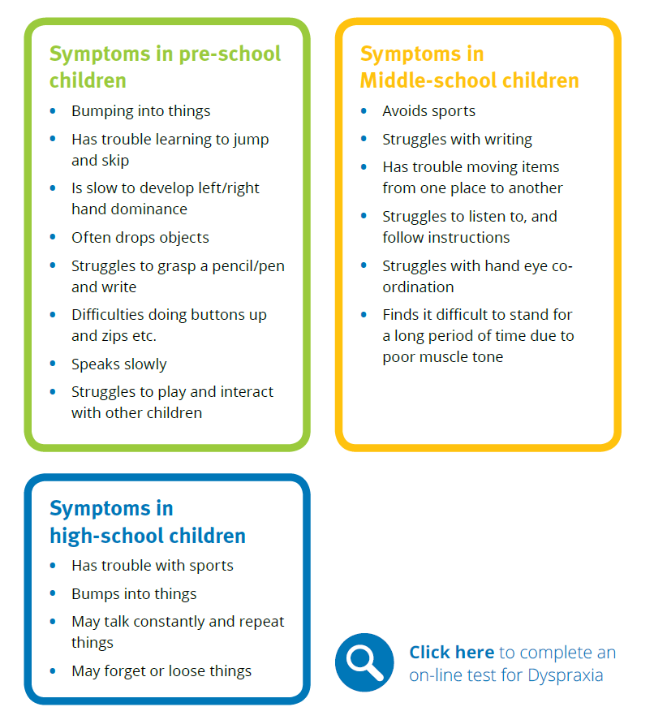
Dyspraxia

Slide 25
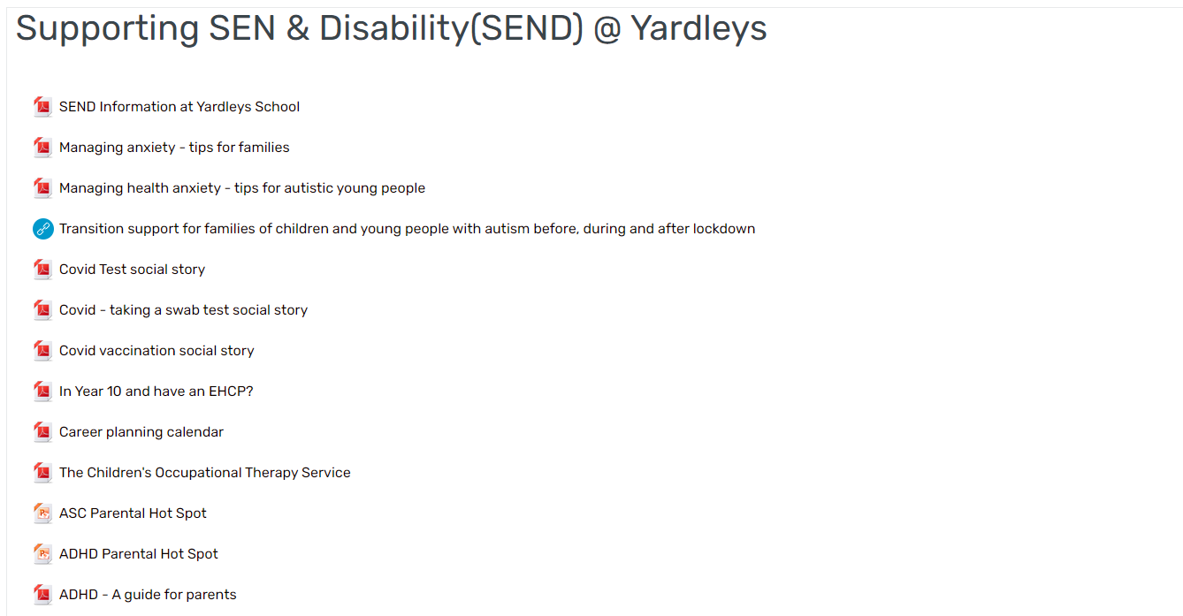


SEND – Parental information

Slide 26

Questions and time to share experiences

