Slide 1

Moderate Learning Difficulties (MLD)
Hot Spot KS4

Slide 2
The SEND team here at Yardleys:
Mrs Begum
Ms Bhambra
Ms Bondos
Ms Chowdhury
Mrs Crew – HLTA 4
Ms Hackett
Ms Kauser
Ms Mitchell
Mrs Morris
Ms Wareham – Administrator
Mr Thornton - SENCo

Slide 3
Curriculum Intent - SEND
The curriculum is successfully adapted, designed or developed to be ambitious and meet the needs of pupils with SEND, developing their knowledge, skills and abilities to apply what they know and can do withy increasing fluency and independence.

Slide 4
Yardleys SEND Vision
Our vision is that regardless of need or disability all students at Yardleys School receive a high-quality and ambitious education. Students with special educational needs and/or disabilities will have their needs identified and supported throughout their time here at Yardleys to ensure they receive an inclusive learning provision. This support will have a positive impact on their overall academic and holistic progress, allowing them to grow as individuals similar to students without special educational needs and/or disabilities.
As a result of the provision provided by the school, students with special educational needs and/or disabilities can fluently access the skills they need to become independent learners and thinkers throughout their lives, allowing them to accomplish their dreams and live their lives to the fullest.
Here at Yardleys School we achieve our vision by:
- Supporting the students identified as SEND as efficiently as possible through deploying resources effectively from their initial transition all the way to their progression into Post-16 provision. This enables them to successfully engage in, not only teaching and learning, but also in areas of the wider curriculum such as extracurricular activities, enrichment, student leadership and Personal Development.
- Working collaboratively with teaching staff, outside agencies, parents and students so that we can maximise the outcome for students with special educational needs and/or disabilities.
- Developing staff and student awareness, understanding and empathy towards our students with special educational needs and/or disabilities to ensure we continue to foster an inclusive environment where all can thrive.

Slide 5
MLD – Moderate Learning Difficulties
Norwich and Ylonen (2013) argue that the most disputed and under researched area of special educational needs is that of moderate learning difficulties (MLD), even though it is identified as the most significant need within most schools (Hatton, Emerson, 2016). On the Code of Practice at present within Yardleys, 62 pupils are identified with MLD as their primary need, however a further 14 are identified with it as their secondary one, identifying 76 pupils with MLD out of a total of 165 on the code, approximately 46%.

Slide 6
What are moderate learning difficulties (MLD)?
A pupil identified as having MLD, will according to the Department for Education definition:
‘…have attainments significantly below expected levels in most areas of the curriculum,..’ and will ‘…have much greater difficulty than their peers in acquiring basic literacy and numeracy skills and in understanding concepts. They may also have associated speech and language delay, low self-esteem, low levels of concentration and under-developed social skills.’ (DfES, 2005:3)

Slide 7


Slide 8
MLD – Moderate Learning Difficulties
Processing is a significant need associated with MLD pupils. Processing is directly related to working memory, which to put it simply, is ‘a mental workspace that we can use to store important information in the course of our mental activities’. Many other learning tasks within school also place a strain upon working memory, such as copying off the whiteboard or listening to and then following a set of verbal instructions, causing a pupil with MLD significant difficulties.

Slide 9

Cognitive Load

Slide 10
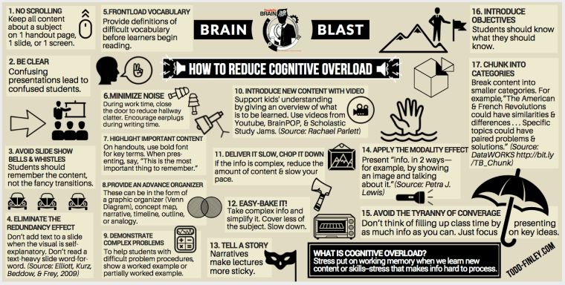
Reducing cognitive overload

Slide 11
MLD – Moderate Learning Difficulties
Interventions and strategies that can be implemented to support teaching and learning include:
1. over-learning to imbed key points
2. scaffolding tasks to allow appropriate access
3.to revise and review prior learning more regularly, as they may not retain it, even from the previous lesson
4.not assuming that because it’s easy for us, that it will be accessible to them.

Slide 12
MLD – Moderate Learning Difficulties
The problem we have as teachers is deciding which strategies to use in order to meet the needs of the MLD pupils, because one type will not suit all. My best advice is to use several throughout the lesson:
Do-Now - quiz could include sentence starters and/or keywords. Remember allow additional time for processing. Try not to have too many questions or too big a task, as it will take too long to complete.

Slide 13
MLD – Moderate Learning Difficulties
Main lesson activities need to be short, repetitive and varied in order to build upon the knowledge or thing you want them to learn. A visual activity, followed by a short written activity, followed by a simple plenary to consolidate what has been learnt.
All printed resources and materials need to be in 14 point font and a friendly text format, such as Comic Sans or Berlin Sans.

Slide 14
MLD – Moderate Learning Difficulties
Revision and exams
Pupils identified with MLD may find revision difficult, especially when it comes to remembering content, which methods to use and most importantly, for how long!
Short 30 minute sessions are best, as this allows the brain to take on board what has been revised. Then have a break, and go and do something else, including helping out with chores, relaxing, watching T.V., a walk or playing a game. Then choose a different subject and revise for another 30 minutes, again followed by a break, before beginning revision again.
What is revision?
Going through the work in your book to learn it for a test.

Slide 15
Why is revision important?
Revision is important because it helps us to understand the topics in the test being taken.
Revision also helps us to remember what we have learnt and to memorise this information.
Finally revision is important because it helps us to practice planning and writing answers to questions.

Slide 16
Organising your revision
Make a revision plan and stick it onto the fridge, or something that the pupil has clear access to:
make a revision timetable - start revising at least five or six weeks before your exams start. Set yourself realistic goals.
balance your subjects – Maths on a Monday for the first session, then Biology for the second, History first session Tuesday, then Chemistry for the second etc.
identify key topics – what will come up in the exam?
2. Get a good nights sleep before each exam/ over exam weeks
3. Don’t leave revision to the last moment. If possible revise all year round!

Slide 17
MLD – Moderate Learning Difficulties
Helping with revision:
Choose appropriate revision activities – although every pupil will use similar methods to revise, it does not mean that they are the best ones for them. It’s a good idea to try out several different methods, including keywords, flashcards, spider diagrams, visual mind maps, jeopardy, GCSE Pod, self quizzing, etc

Slide 18
Revision Time table
Day | Morning | Afternoon | Evening
Monday | School | School
Tuesday | School | School
Wednesday | School | School
Thursday | School | School
Friday | School | School
Saturday
Sunday

Slide 19
THREE ways to revise:
Keywords – using a highlighter, find keywords and write down what they mean.
Flashcards – use flashcards to write down facts and then learn them. Use 1 flashcard for each fact.
Visual mind maps – use pictures to help you learn and remember information.

Slide 20

Keywords
Why is revision important?
To understand the topics in the exam being taken.
Meaning – the subject you are learning about

Slide 21
Flashcards
Who were the THREE contenders for the English throne in 1066?
Harold Godwinson
William of Normandy
Harald Hardrada

Slide 22
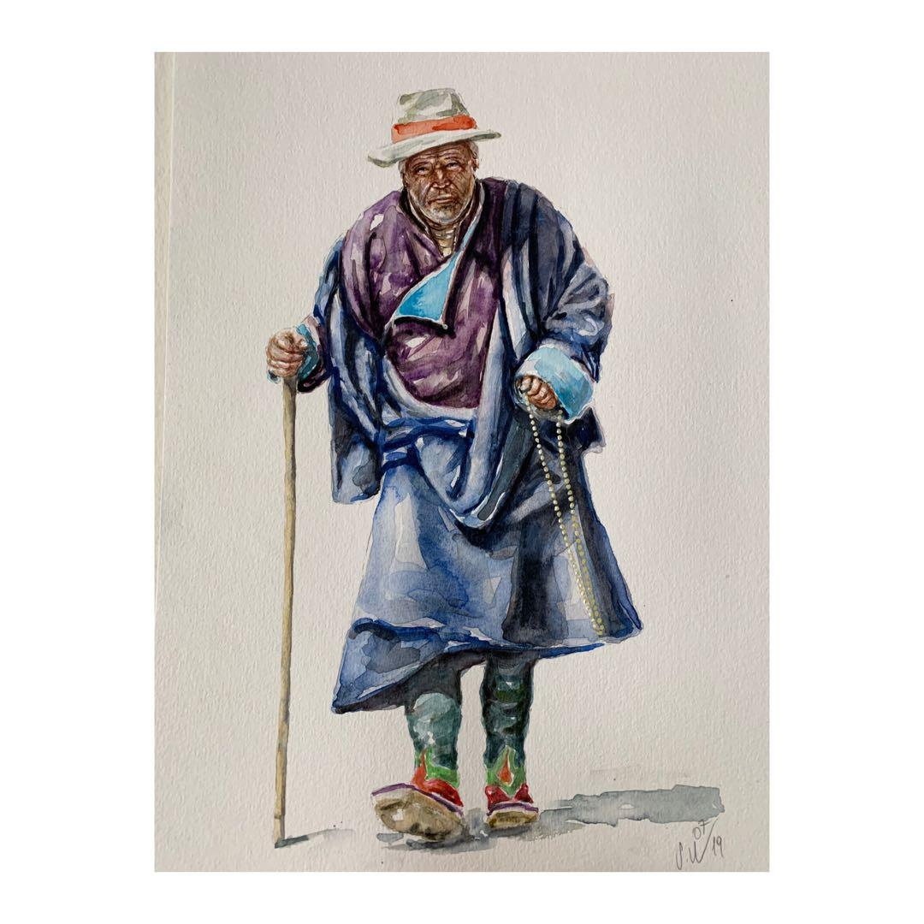

Visual mind map:
What 4 things did Siddhartha see when he left the palace?

Slide 23
Revision Time table
Day | Morning | Afternoon | Evening
Monday | School | School | Maths
Tuesday | School | School | Science
Wednesday | School | School | Geography
Thursday | School | School | History
Friday | School | School | English
Saturday | French | Maths | RE
Sunday | English | History | Science
Use this blank revision time table to make your own.
Day | Morning | Afternoon | Evening
Monday | School | School
Tuesday | School | School
Wednesday | School | School
Thursday | School | School
Friday | School | School
Saturday
Sunday

Slide 24
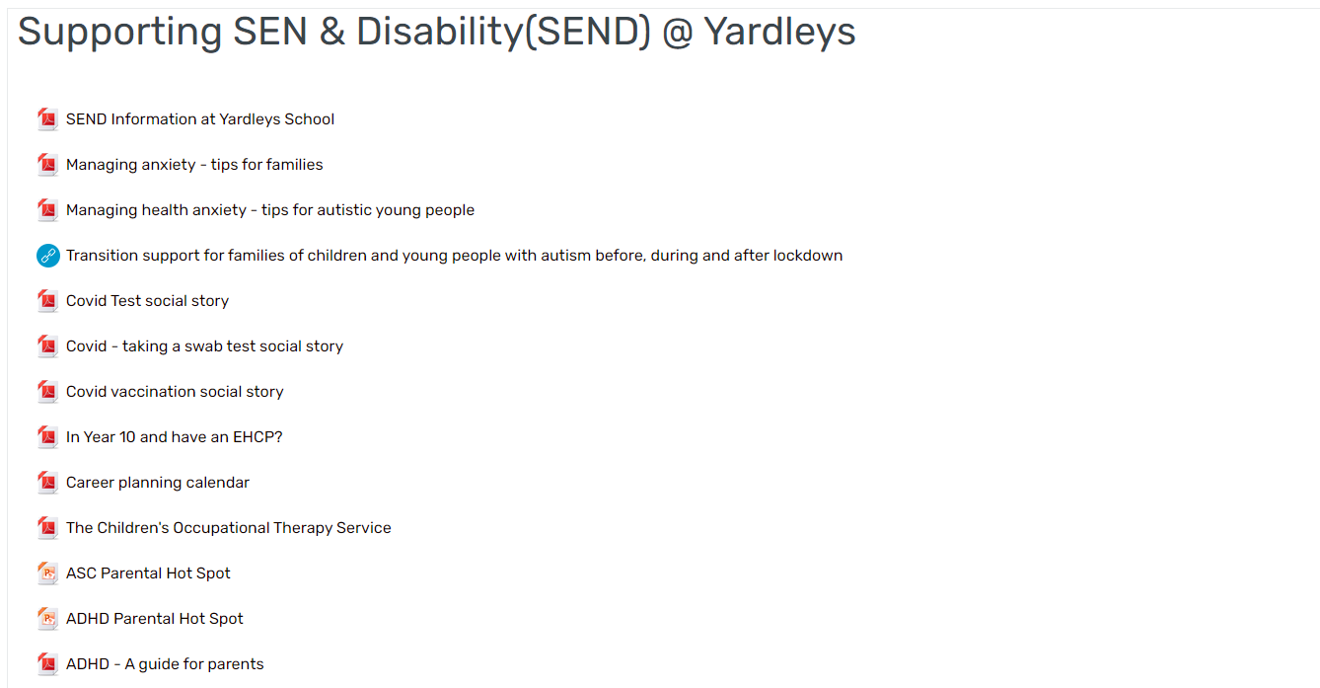


SEND – Parental information

Slide 25

Questions and time to share experiences

