Slide 1





Welcome to this parents workshop on
supporting your child with their maths homework.

Slide 2
Curriculum Intent - SEND
The curriculum is successfully adapted, designed or developed to be ambitious and meet the needs of pupils with SEND, developing their knowledge, skills and abilities to apply what they know and can do with increasing fluency and independence.

Slide 3
Our Vision
Our vision is that, regardless of need or disability, all students at Yardleys School receive a high-quality and ambitious education. Students with special educational needs and/or disabilities will have their needs identified and supported throughout their time here at Yardleys to ensure they receive an inclusive learning provision that has a positive impact on their overall academic and holistic progress, allowing them to grow as individuals at the same rate as students without special educational needs and/or disabilities. As a result of the provision provided by the school students with special educational needs and/or disabilities can fluently access the skills they need to become independent learners and thinkers throughout their lives, allowing them to accomplish their dreams and live their lives to the fullest.
Here at Yardleys School we intend to achieve our vision by:
- supporting the students identified as SEND as efficiently as possible by deploying resources effectively so they can engage in not only teaching and learning but also extra-curricular activities and the CEIAG program
- working collaboratively with teaching staff, outside agencies, parents and students so that we can maximise the outcome for students with special educational needs and/or disabilities
- developing staff and student awareness, understanding and empathy towards our students with special educational needs and/or disabilities to ensure we continue to foster an inclusive environment where all can thrive.

Slide 4
The SEND team here at Yardleys:
Ms Ahmed
Ms Ali
Mrs Begum
Ms Bondos
Ms Chowdhury
Mrs Crew – HLTA 4
Ms Hackett
Ms Kauser
Mrs Morris
Agency TA’s – Anjum Ahmed ; Mehroosh Qsaim
Ms Wareham – Administrator
Mr Thornton – SENCo
SLT Lead – Ms Yates

Slide 5
Aims of our session:
Provide you with a Homework Booklet which you can use to support your child at home.
MATHS
HOMEWORK
SUPPORT
BOOKLET
FOR
KS3
Share with you some information and examples which you can use at home to support your child with their homework.

Slide 6
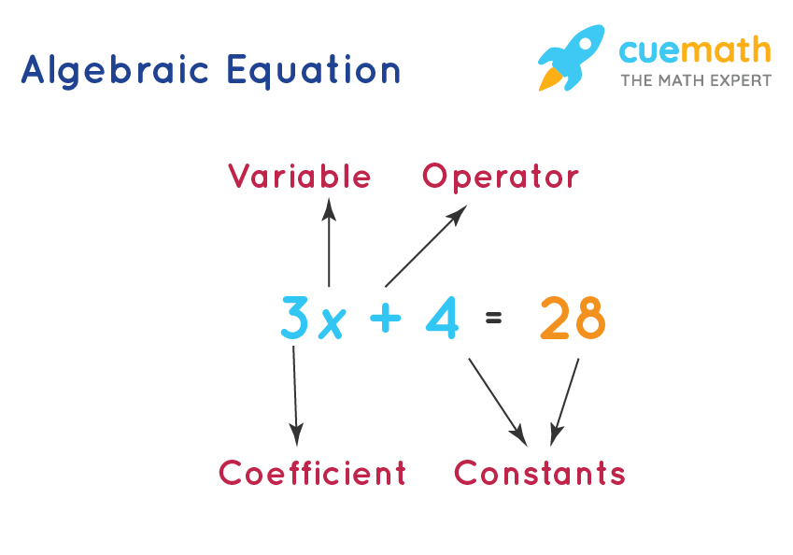
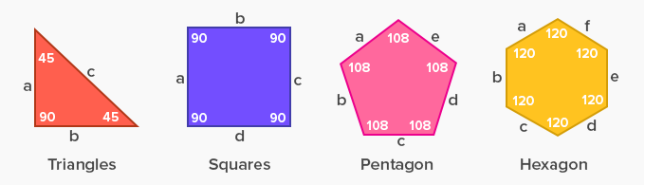
MATHS
HOMEWORK
SUPPORT
BOOKLET
FOR
Parents
KS 3

Slide 7
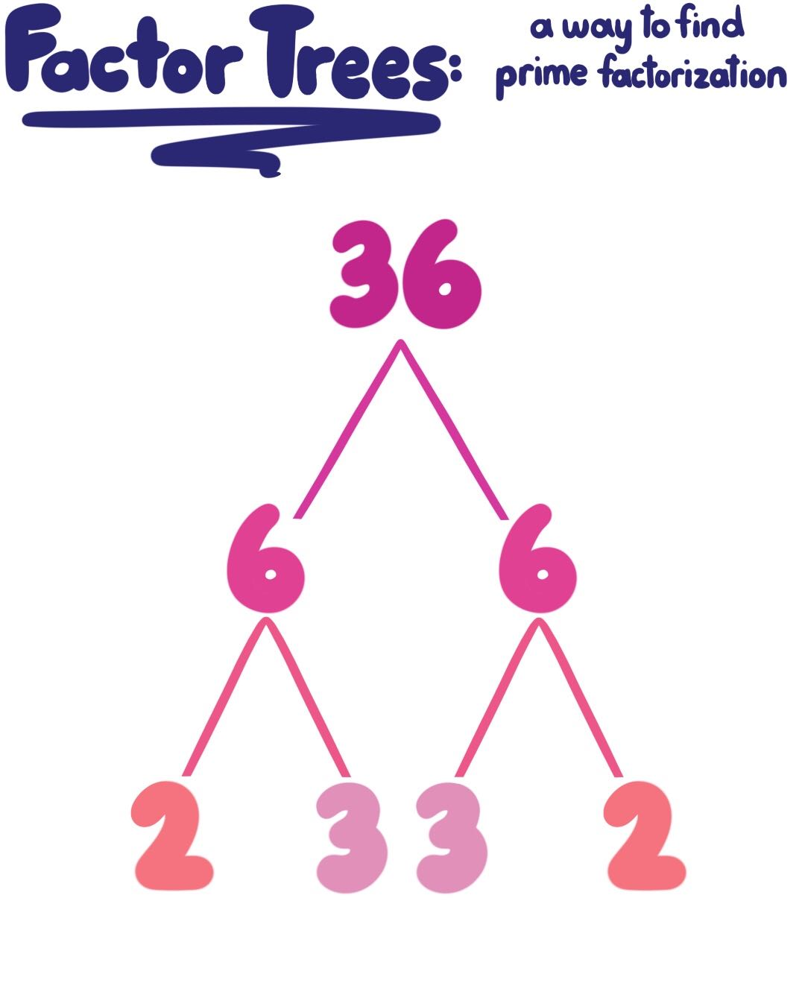
A prime factor is a factor of a number which is also prime. We will discover just how important these prime factors are!
Prime factors only have TWO factors 1 and itself.
The first 10 prime numbers: 2,3,5,7,11,13,17,19,23,29
For example, 2 is prime number which is a factor of 6.
Therefore 2 is a prime factor of 6.
Index Form
2x2x3x3
= 2²x 3²

Slide 8
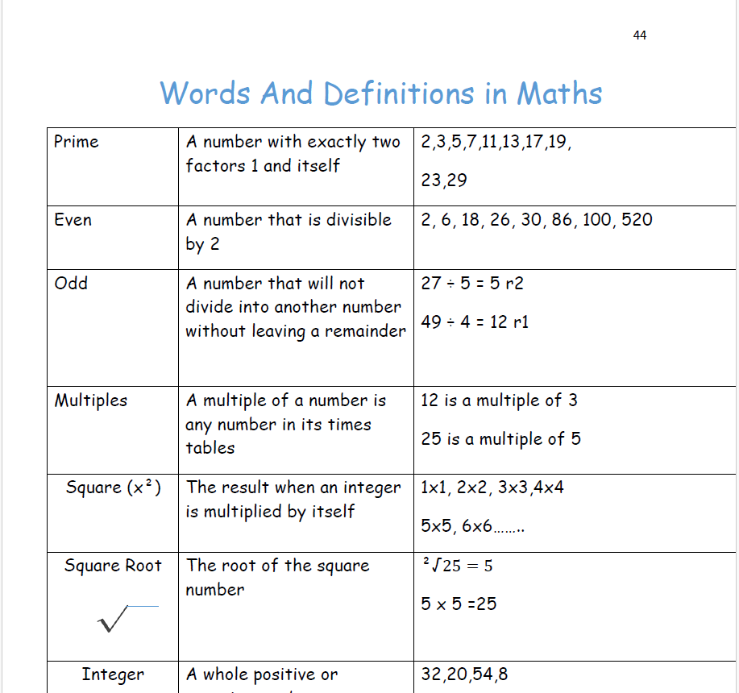
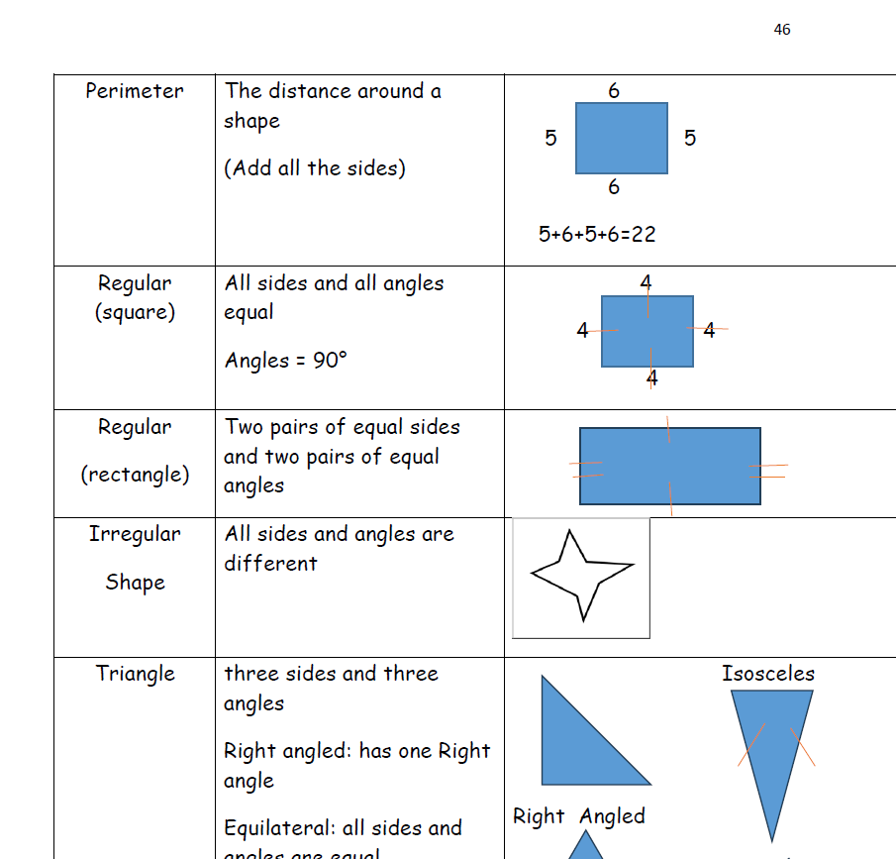

Slide 9
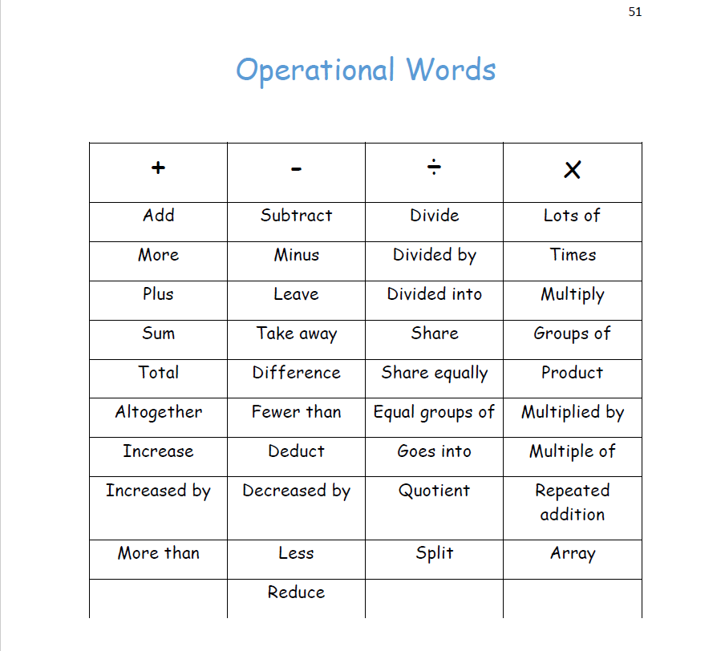

Slide 10

HOMEWORK SUPPORT
Monday: In the SEND room till 4 pm
With the use of computers

Slide 11

Questions and time to share experiences

Slide 12
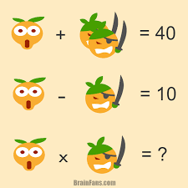
Questionnaire
Time
Can you now please
Fill in the
questionnaire

Slide 13


