Slide 1
Yardleys Student Leadership

Slide 2
School Council process/ life cycle
3 sub committees meet
Academic Excellence
Whole child
Collaboration
The committees would meet to discuss issues and create the agenda for form council meetings
Form council meetings across the school, led by form captains.
3 sub committees meet
To feedback and collate minutes from form council
School Council meet with WRN/BXG to discuss the agenda items and the feedback from students.
Minutes of school council meeting is sent out to forms

Slide 3
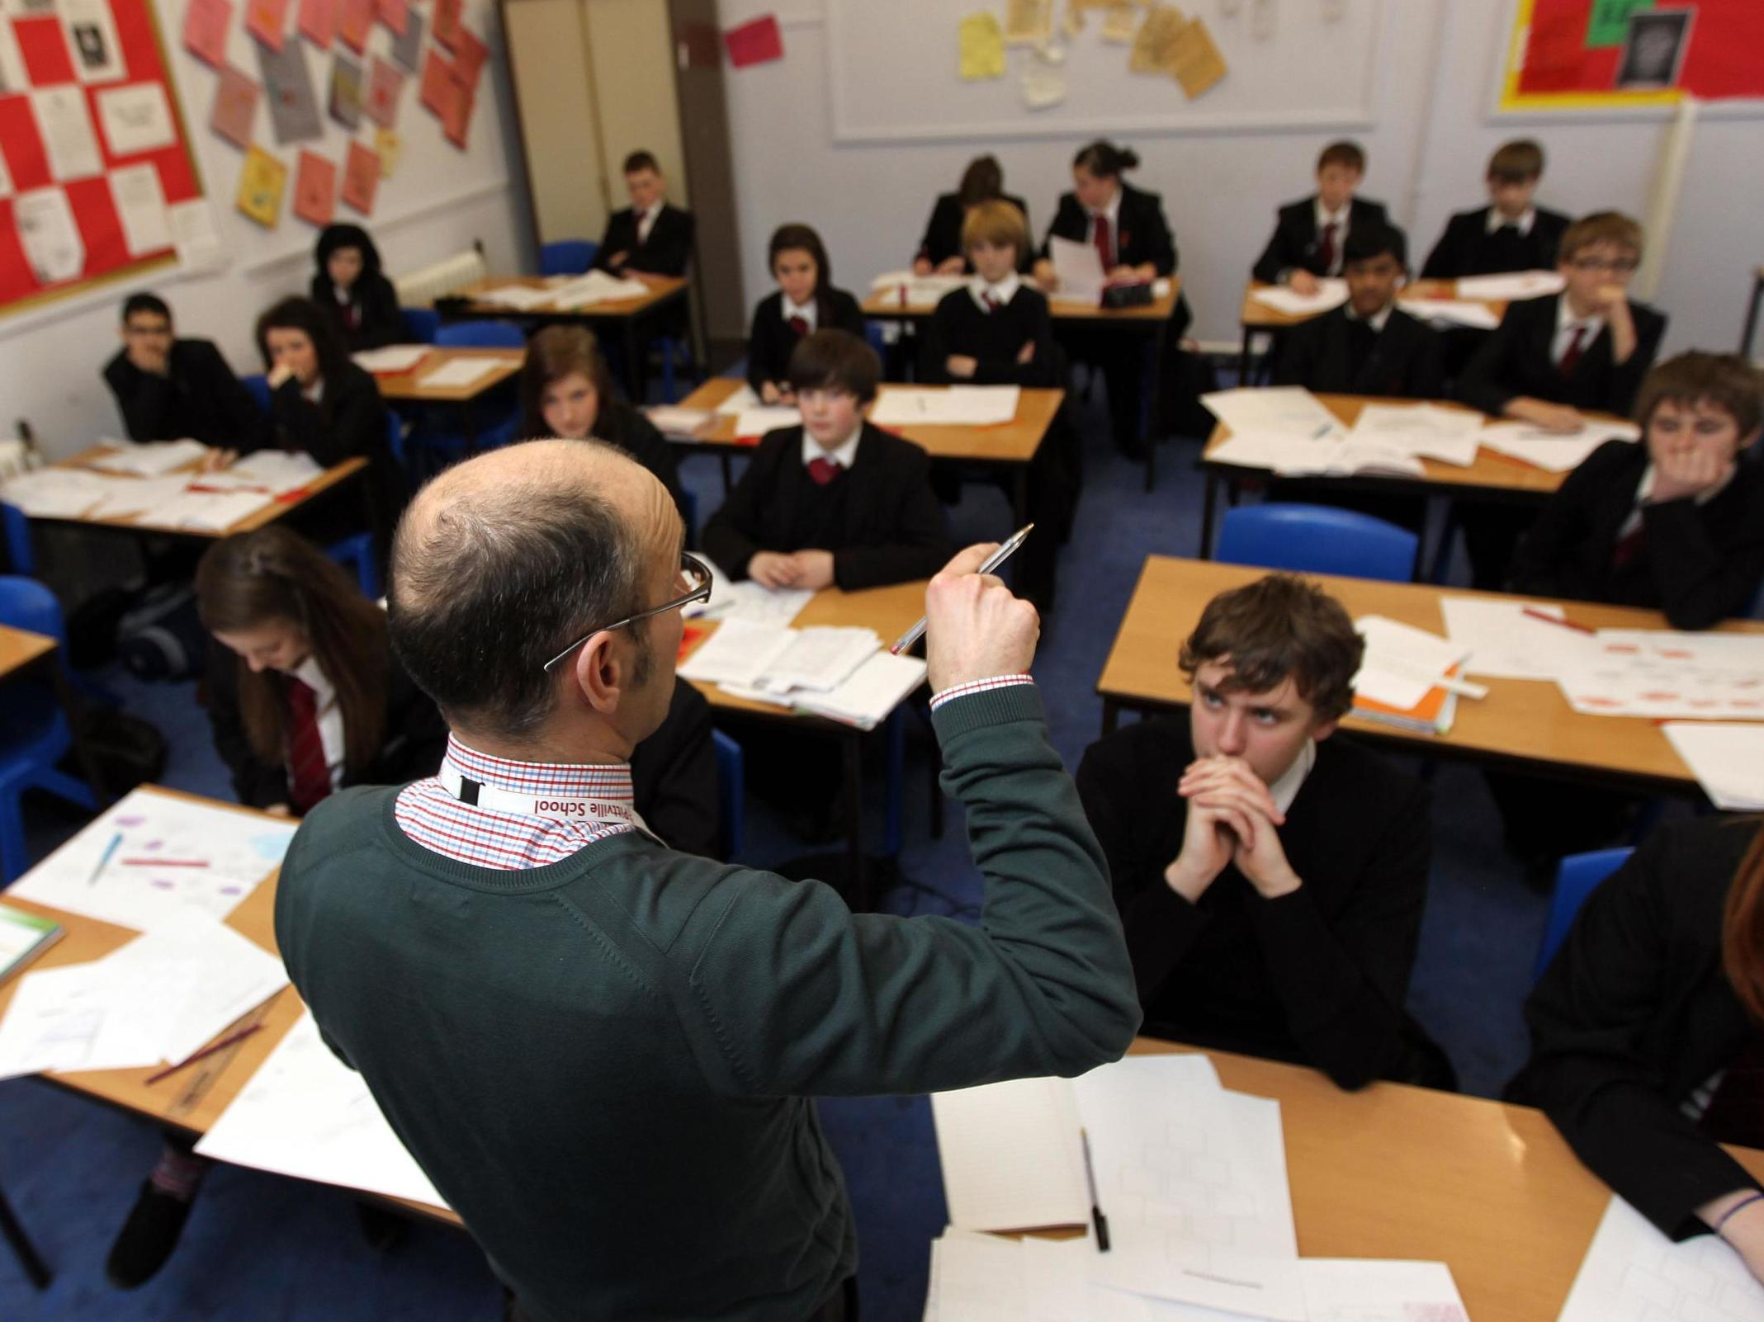
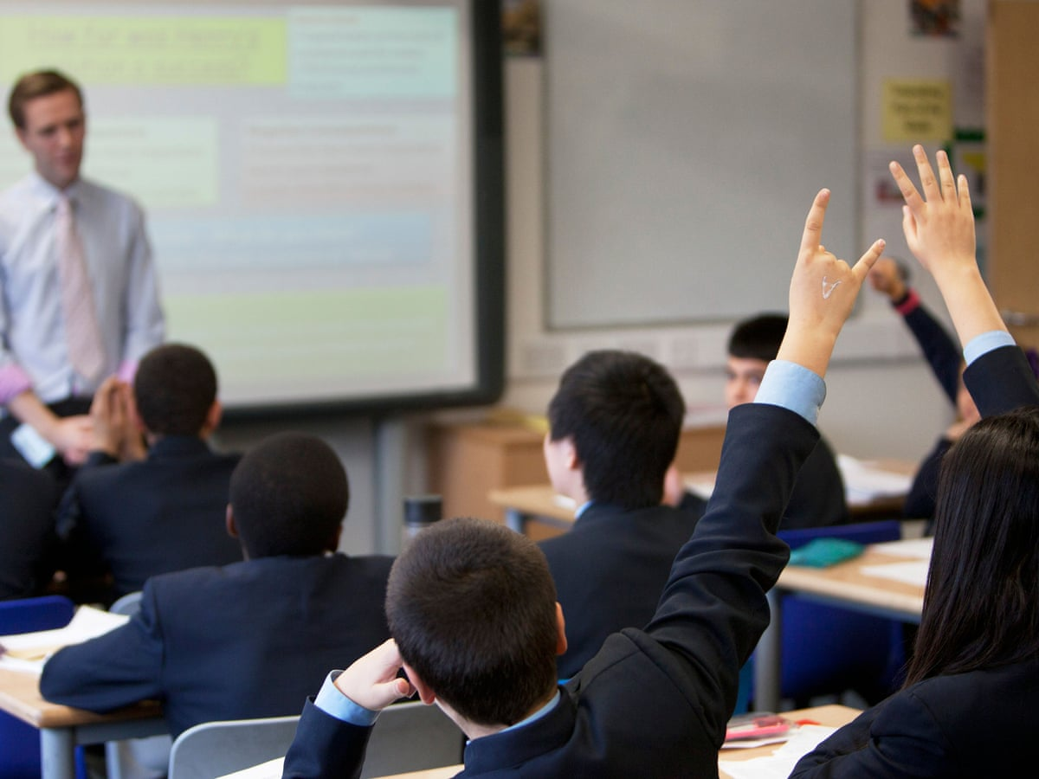
Sub Committees
1. Academic Excellence:
Lessons/ learning/ Behaviour
Curriculum
Pedagogy
Homework

Slide 4
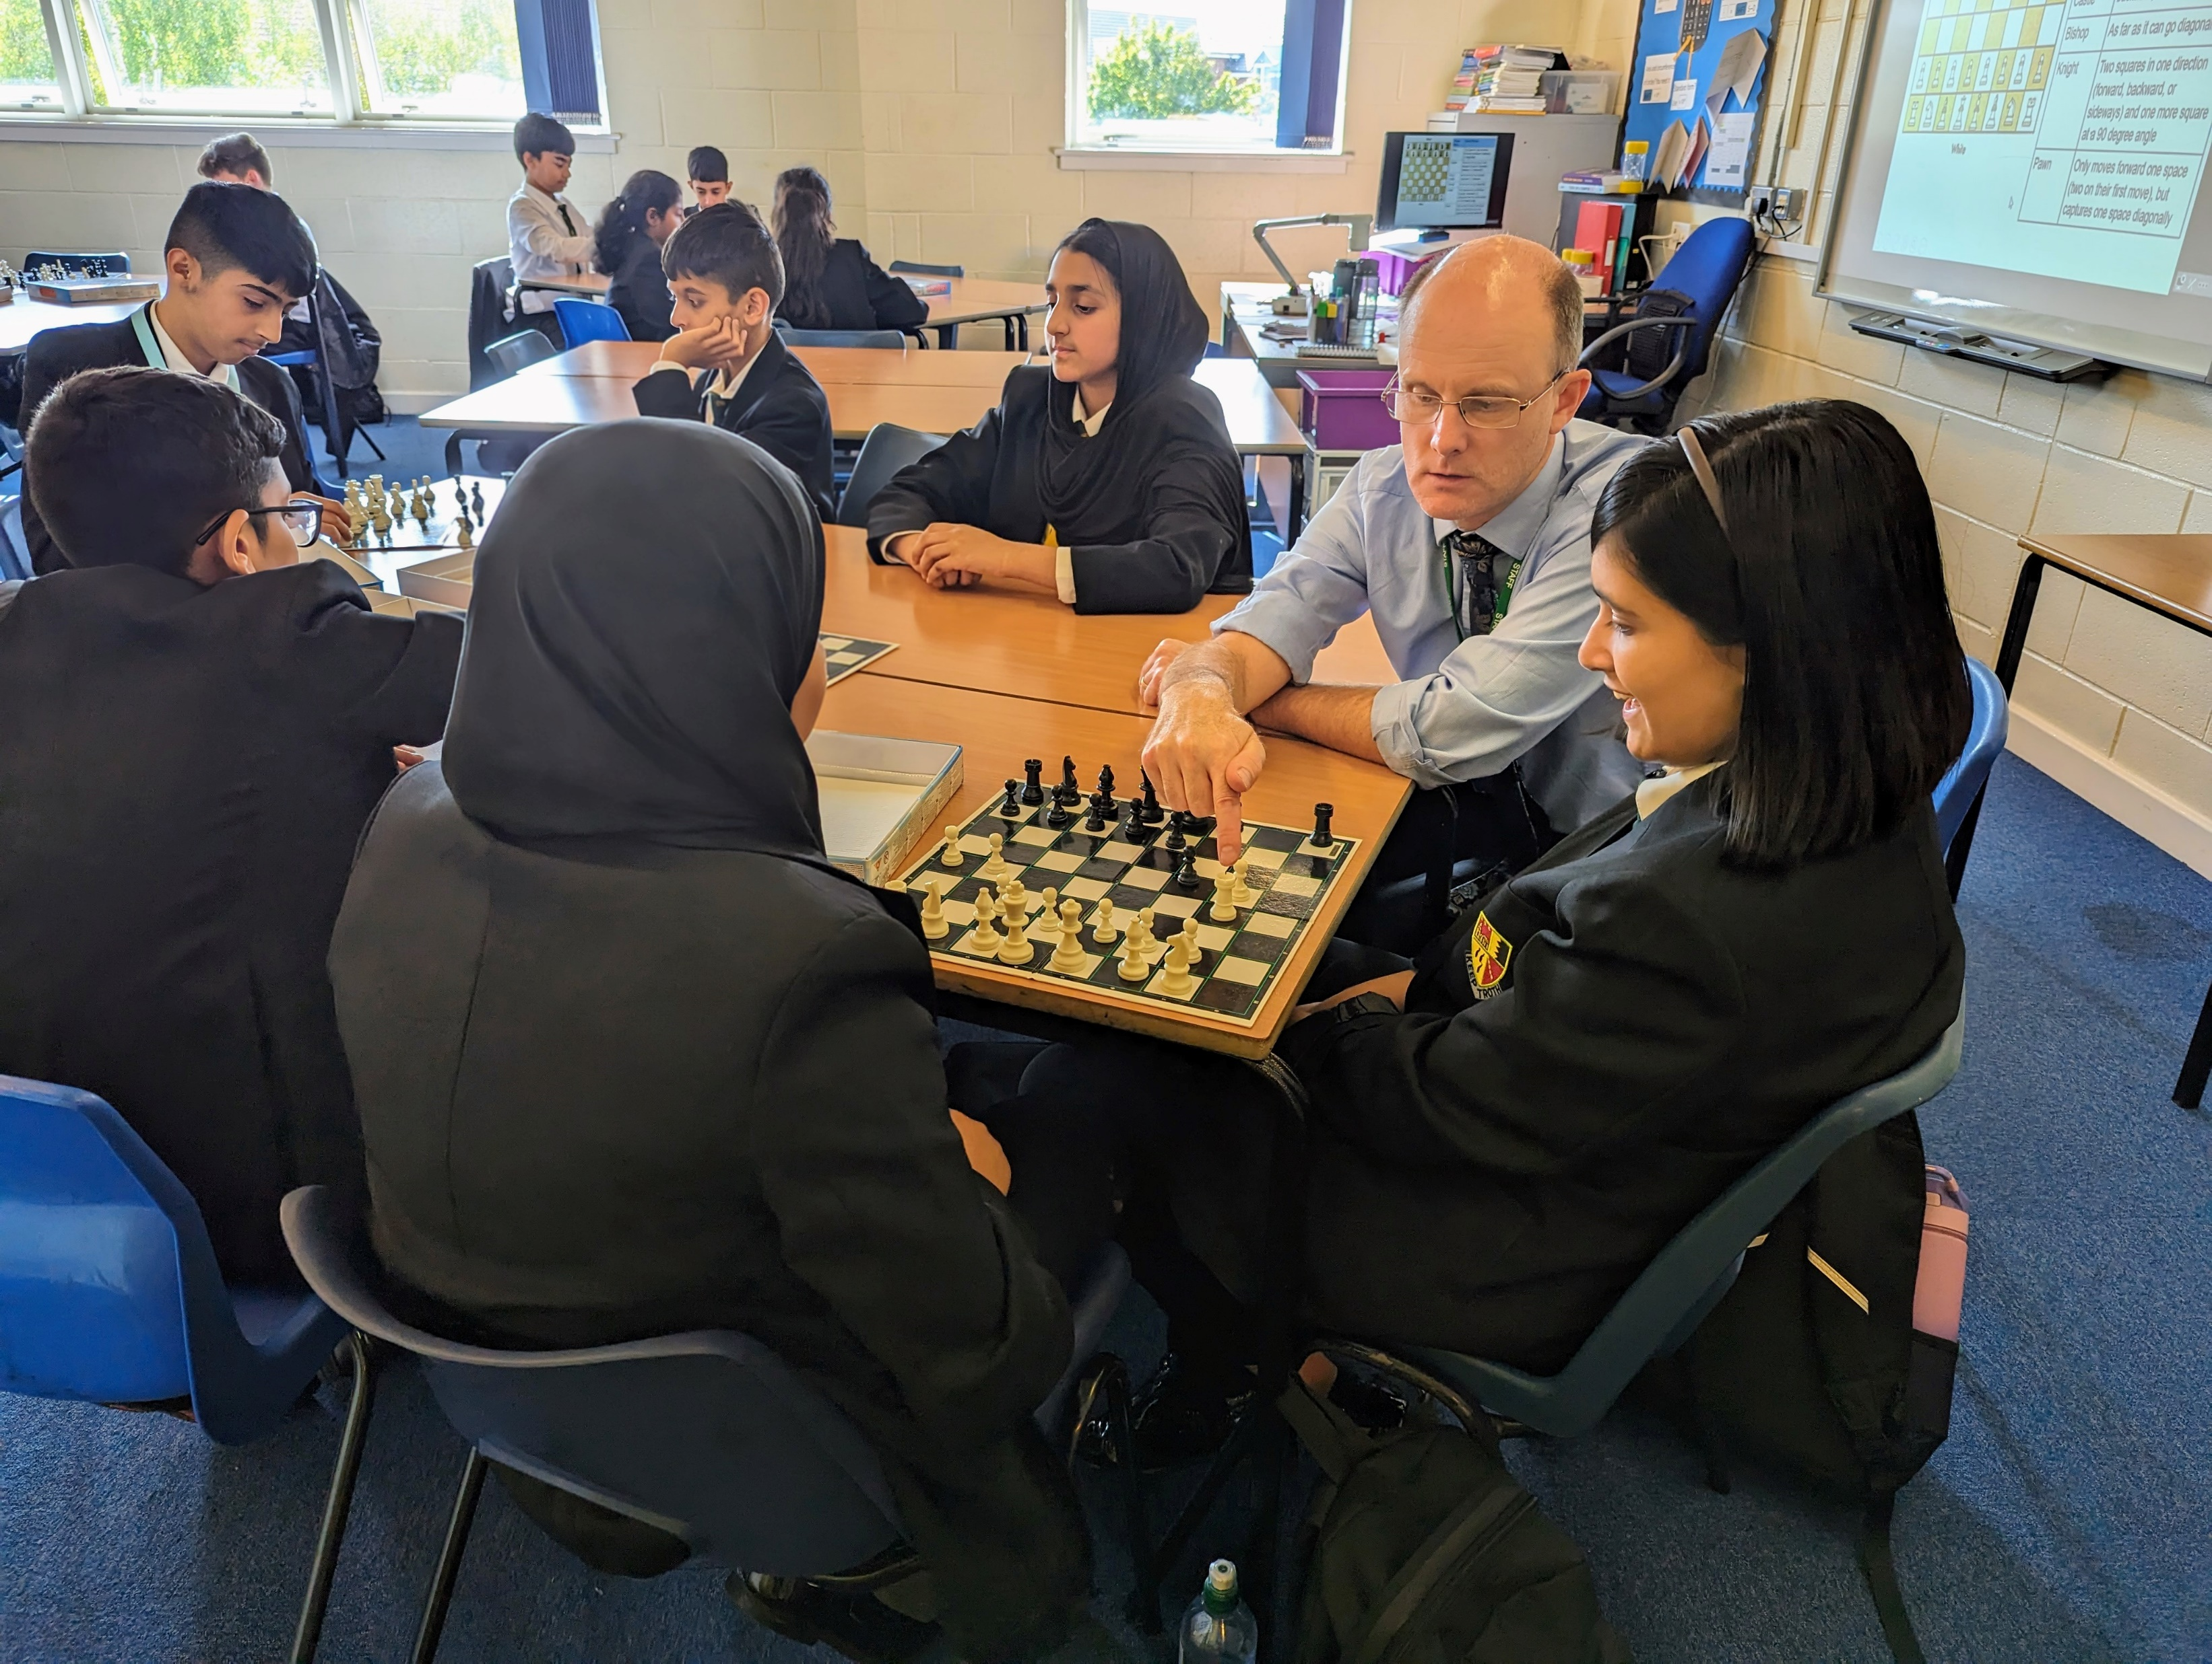
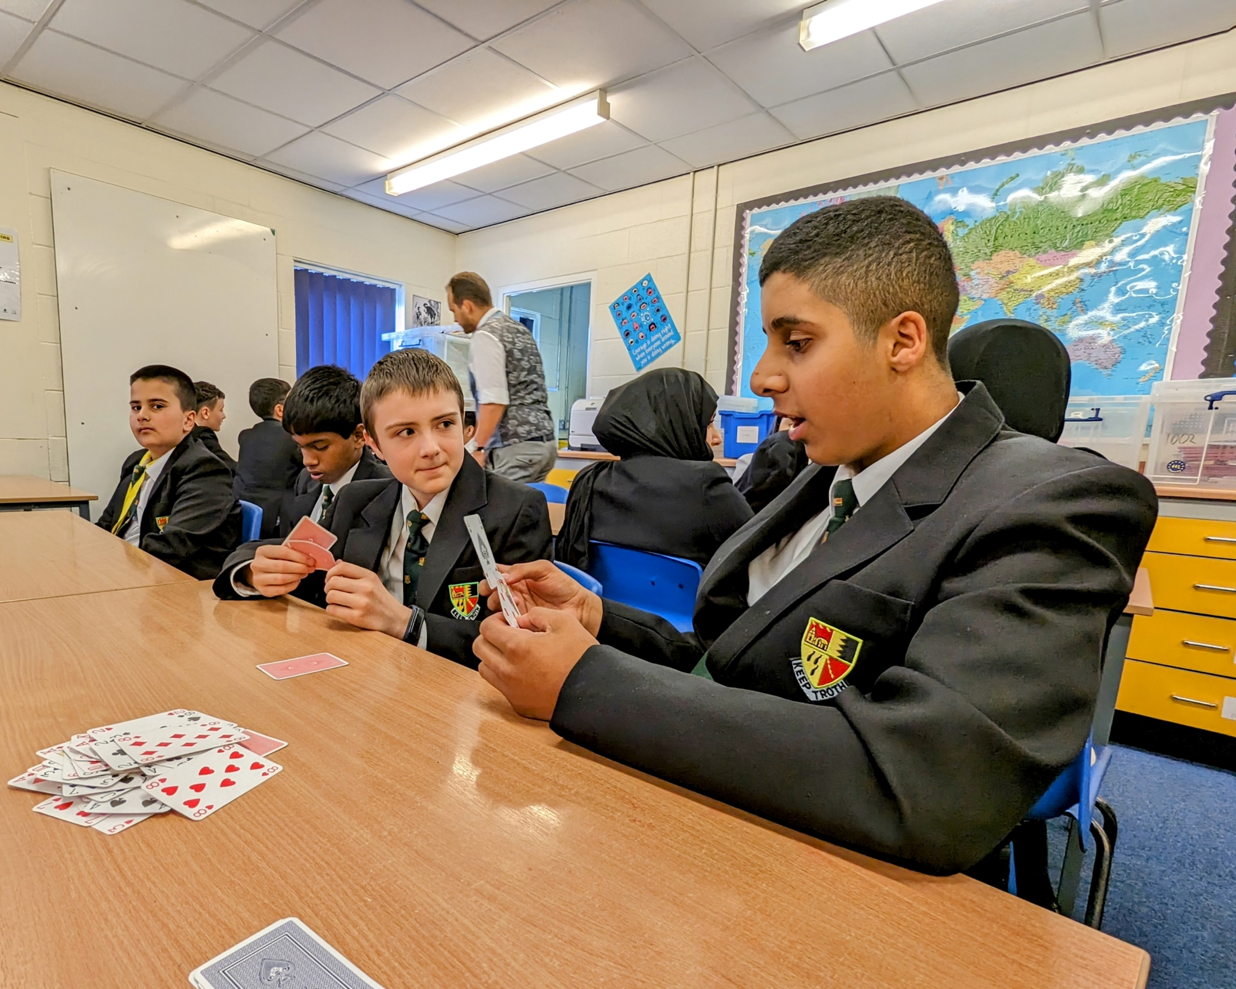
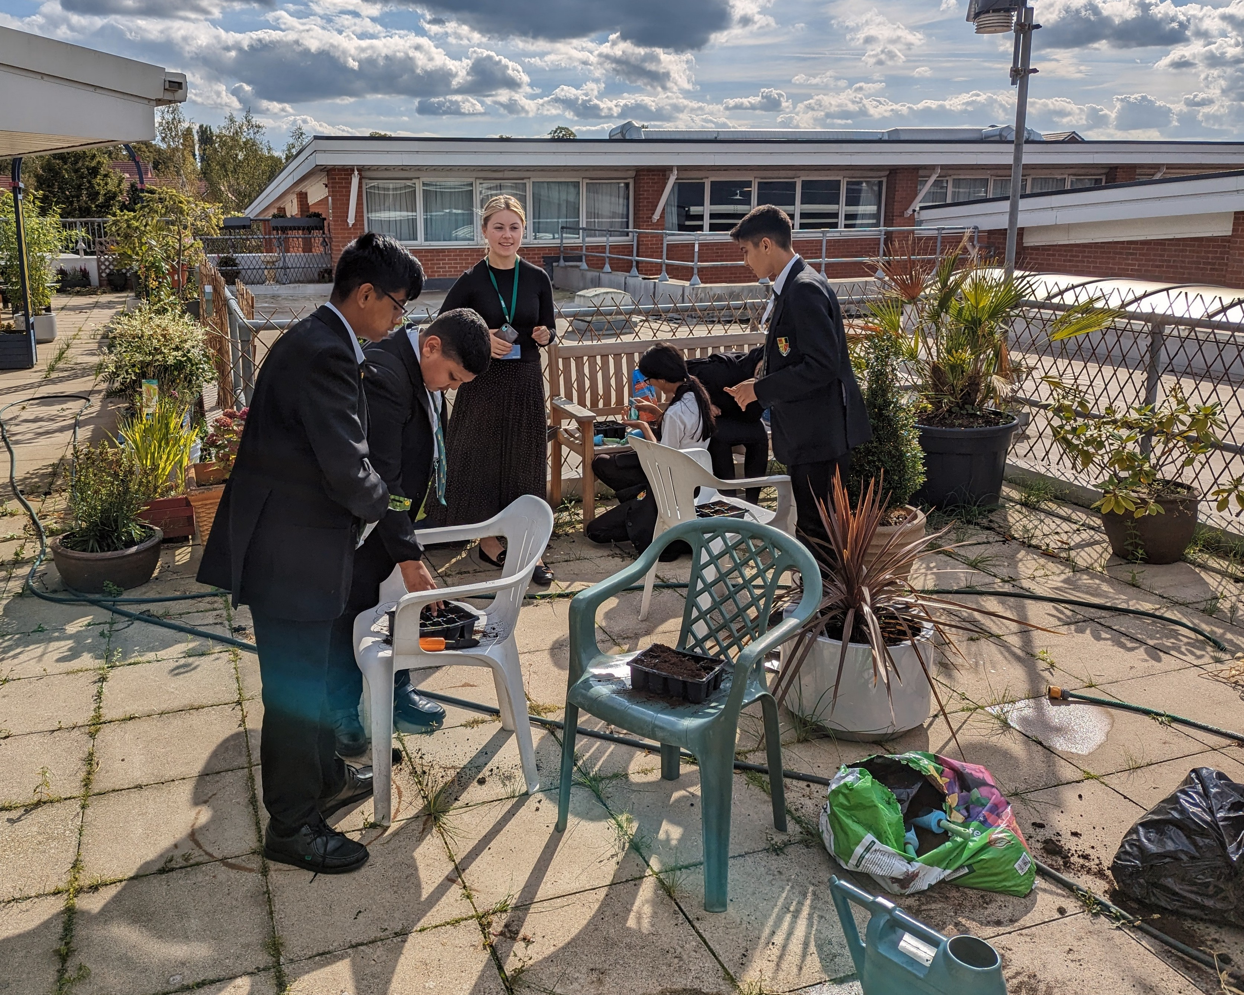
Sub Committees
2. Whole Child:
PD
Enrichment
Pastoral
SMSC

Slide 5
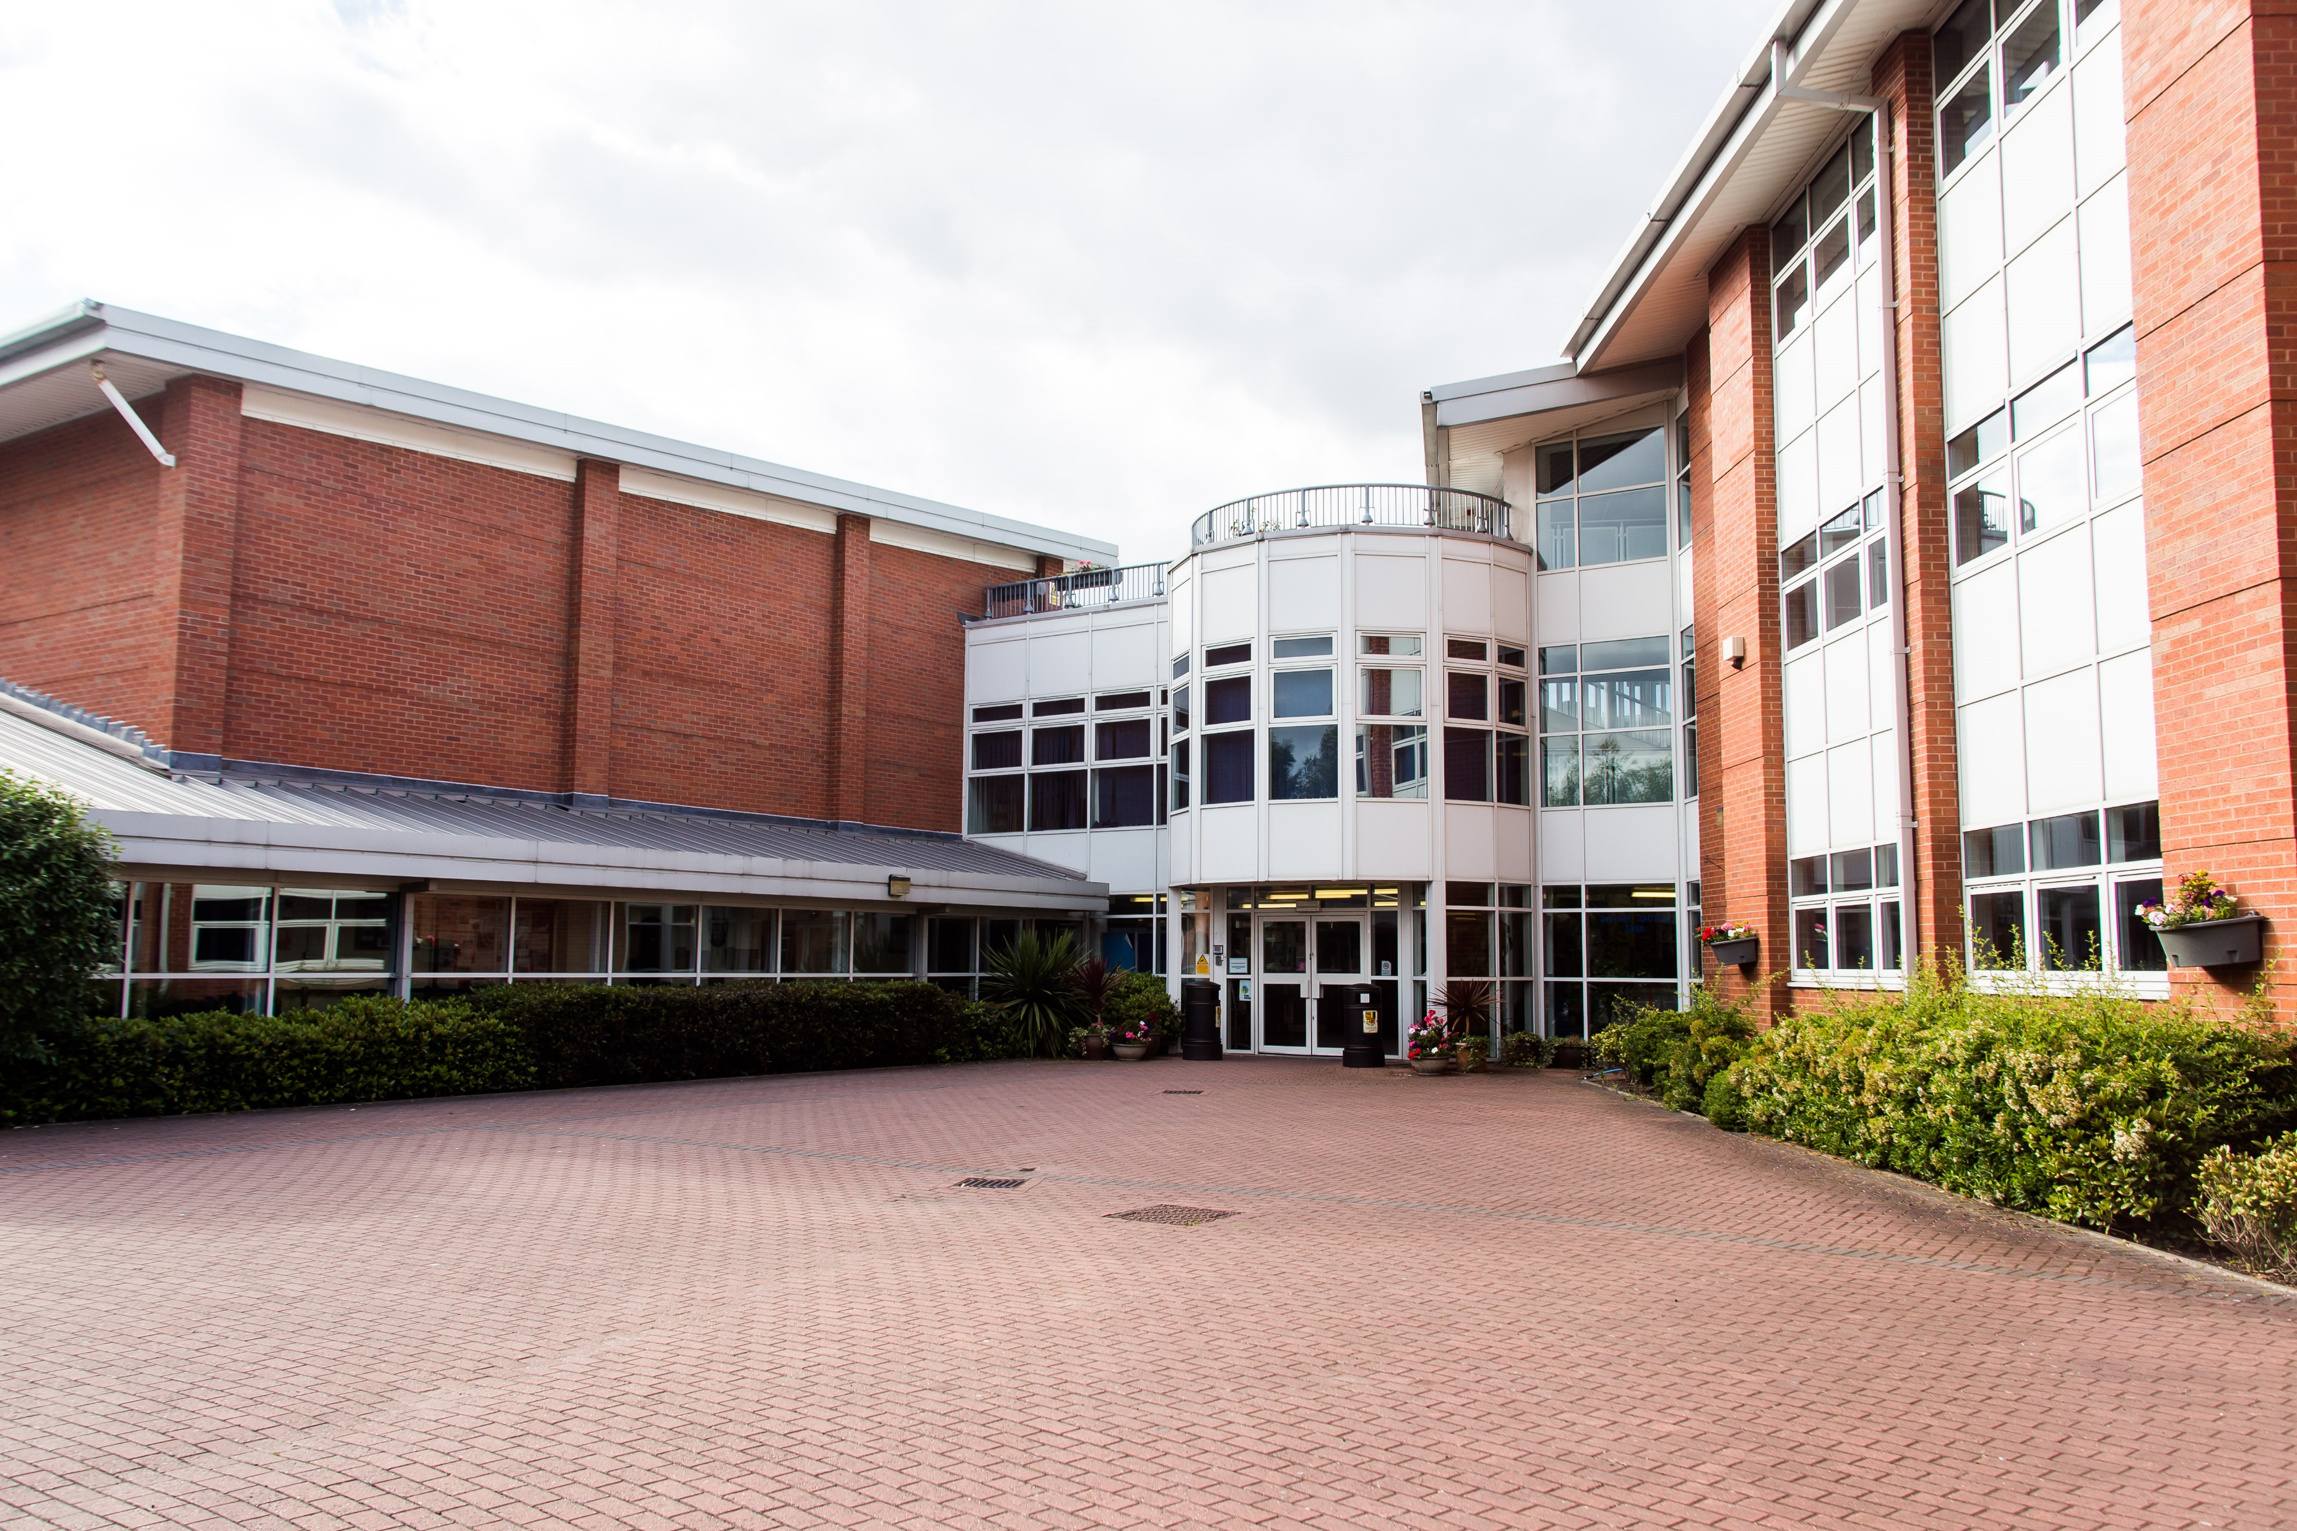
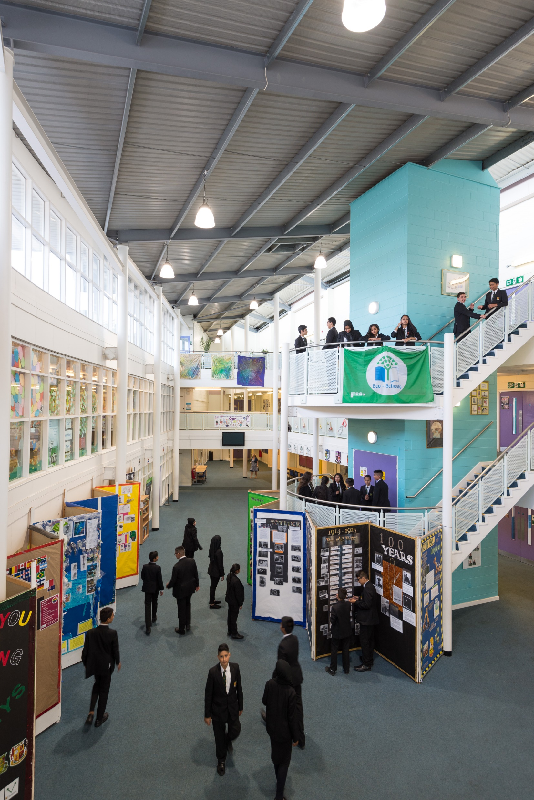
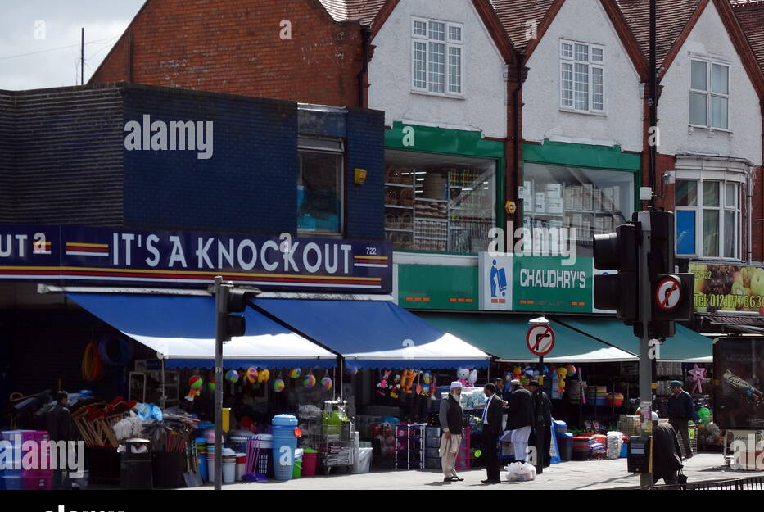
Sub Committees
3. Collaboration:
- School environment
Social times
School structure/ processes
Local community
Parents/ carers

Slide 6
Form Council
Now over to you, in your committee groups, you are going to decide what the next form council will be about.
In each of the area's (Academic, Whole Child and collaboration) what do you feel is most important? What feedback do you want?
Put your ideas down on the sheet and then the 'chair-person' will type them up and submit them to Mr Zeibeck, ready for the form council next half term.

