Slide 1

Access Arrangements
At Yardleys

Slide 2
The SEND team here at Yardleys:
Ms Ahmed
Ms Ali
Mrs Begum
Ms Bondos
Mrs Crew – HLTA 4
Ms Hackett
Ms Kauser
Mrs Morris
Agency TA’s – Anjum Ahmed ; Mehrosh Qasim; Bina Pancholi
Ms Wareham – Administrator
Mr Thornton – SENCo
SLT Lead – Ms Yates

Slide 3
Curriculum Intent - SEND
The curriculum is successfully adapted, designed or developed to be ambitious and meet the needs of pupils with SEND, developing their knowledge, skills and abilities to apply what they know and can do withy increasing fluency and independence.

Slide 4
Yardleys SEND Vision
Our vision is that regardless of need or disability all students at Yardleys School receive a high-quality and ambitious education. Students with special educational needs and/or disabilities will have their needs identified and supported throughout their time here at Yardleys to ensure they receive an inclusive learning provision. This support will have a positive impact on their overall academic and holistic progress, allowing them to grow as individuals similar to students without special educational needs and/or disabilities.
As a result of the provision provided by the school, students with special educational needs and/or disabilities can fluently access the skills they need to become independent learners and thinkers throughout their lives, allowing them to accomplish their dreams and live their lives to the fullest.
Here at Yardleys School we achieve our vision by:
- Supporting the students identified as SEND as efficiently as possible through deploying resources effectively from their initial transition all the way to their progression into Post-16 provision. This enables them to successfully engage in, not only teaching and learning, but also in areas of the wider curriculum such as extracurricular activities, enrichment, student leadership and Personal Development.
- Working collaboratively with teaching staff, outside agencies, parents and students so that we can maximise the outcome for students with special educational needs and/or disabilities.
- Developing staff and student awareness, understanding and empathy towards our students with special educational needs and/or disabilities to ensure we continue to foster an inclusive environment where all can thrive.

Slide 5
The Purpose of Access arrangements
Access arrangements are not there to give students an unfair advantage, but to give all students a level playing field in which to demonstrate their skills, knowledge and understanding.
To reflect the student’s normal way of working in school.

Slide 6
What are Access arrangements?
Access arrangements allow students with specific needs, such as special educational needs and disabilities to access their exams.

Slide 7
How will the process start?
TNR and CWH will work with teachers and the students to identify who in school need access arrangements.
TNR will do a range of tests with students with learning difficulties.

Slide 8
How will the process start?
Various access arrangements are available. For example, support for students who have difficulties with reading, writing, speed of working or concentration.

Slide 9
How will the process start?
Not all students with additional needs will require access arrangements.
This depends on whether their difficulty affects their access to exams. Additional needs or a diagnosis alone do not entitle a student to access arrangements.

Slide 10
Who will make the assessment
Specialists (for example, a medical consultant or a psychiatrist) are responsible for providing a formal diagnosis. They are not responsible for decisions about access arrangements.

Slide 11
Who will make the assessment
TNR and CWH will decide which access arrangements a student has for their exams.
Teachers must give evidence to show that an access arrangement is needed. The school or college will record how effective the arrangement is in the classroom, in internal tests or in mock exams.

Slide 12
What else needs to be done?
CWH will have to apply for some arrangements online by 21st March 2026
Sometimes some arrangements are not straight forward and have to be referred to exams board.

Slide 13
Types of Access Arrangements
Extra Time
Reader or Computer Reader
Read Aloud
Examination Reading Pen
Word Processor
Scribe
Practical Assistant
Enlarged Papers
Coloured paper
Supervised Rest Breaks

Slide 14
‘Normal Way of Working’
The arrangement(s) put in place must reflect the support given to your child in school, e.g.
• in the classroom
• working in small groups
• literacy support lessons
• literacy intervention strategies
• in internal school tests/examinations
• mock examinations

Slide 15
Teaching Assistants Role in exams
They can only help in certain ways
They can’t give you clues like I do in lessons
They can’t give you examples like I do in lessons
They can’t tell you if your answers are right or wrong
They can’t check your work to see if you have understood

Slide 16
Student’s role in exams
They can’t walk around or go to the toilet
They can’t use the computer to check things
They must leave their bag outside
They can only take what they need for the exam (such as a pen or pencil)
They must have nothing in their blazer pockets
No books or mobile phones
They must be quiet and put their hand up if they need help
They will have to stay until the end of the exam time.

Slide 17
How can parents help at home?
Encourage your child to read anything, fiction and non-fiction
Read their work and homework with them and look for any common mistakes
Encourage them to proofread their work
Look for any subject specific vocabulary – ask them to explain and spell these words
Present work with pride and neat handwriting

Slide 18
How can parents help at home? Offer Support & Encouragement
Encouraging them to eat well
Encouraging them to sleep well
Encouraging them to drink water every day
Help them to identify what is causing the stress (and seek support where necessary)
Acknowledge difficult times but remind them that they can cope
Encourage them to work to a weekly timetable or plan around managing out of school time
Encourage them to schedule breaks – resting, walking, listening to music

Slide 19
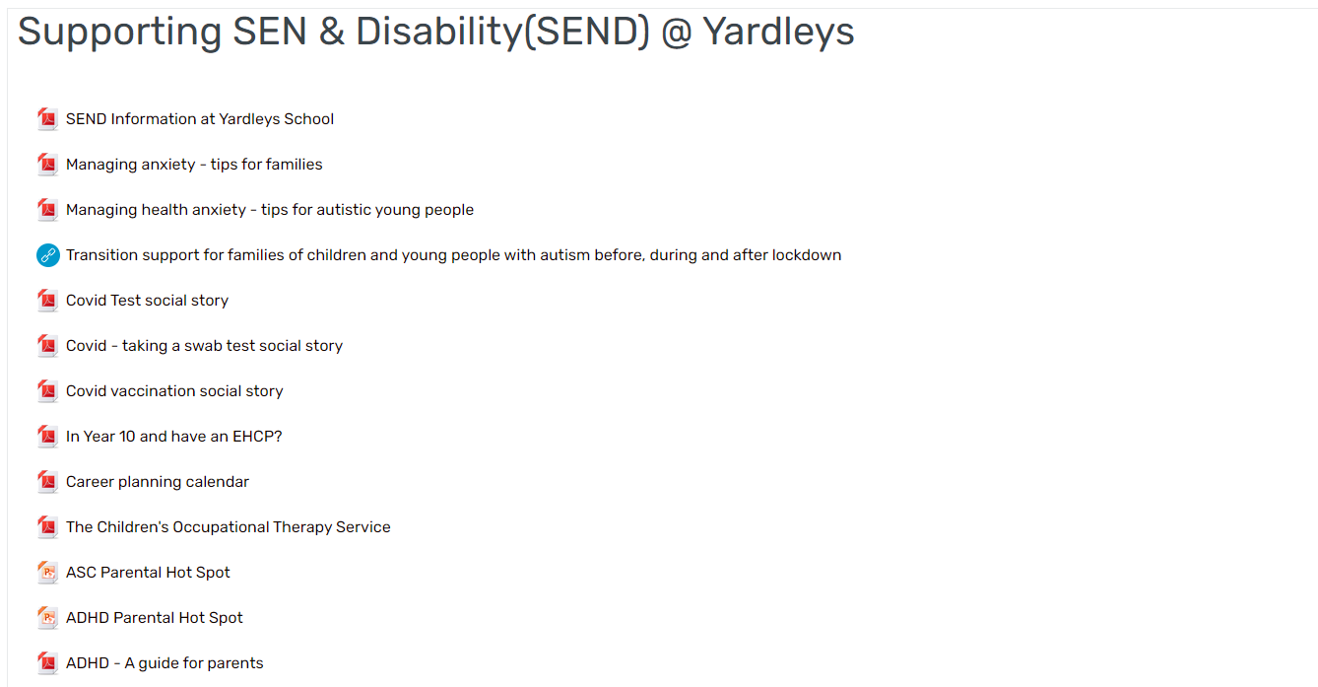


SEND – Parental information

Slide 20

Questions and time to share experiences

