Slide 1
Ethics Booster: Only complete the themes we have studied.
A:
B:
D:
E:
Cross out sections C and F, otherwise you are a Complete Fool.

Slide 2
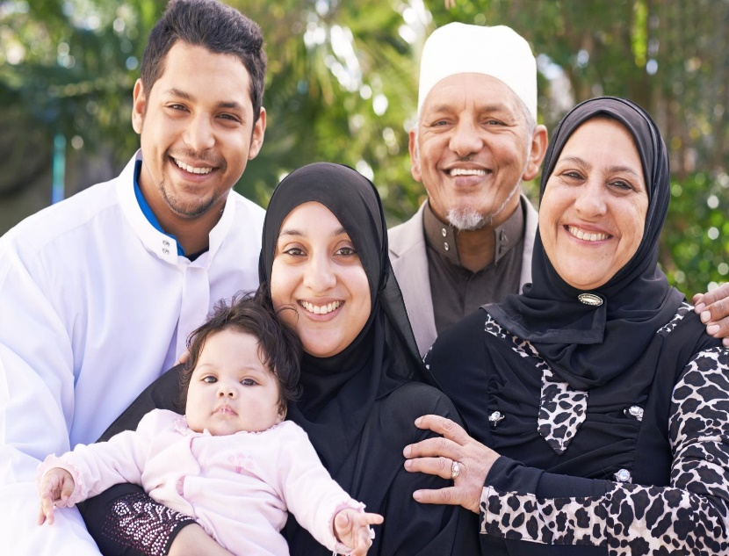
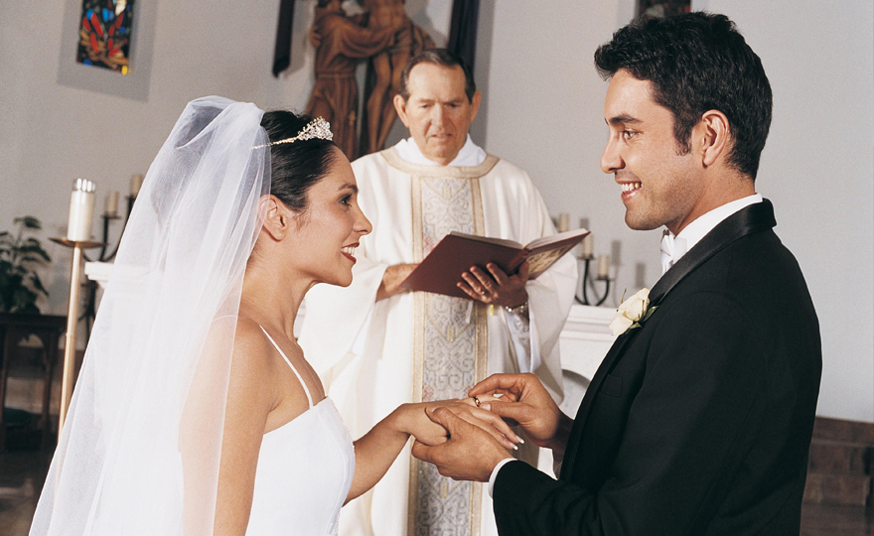
Generally your more conservative - similar views:
Islamic and Roman Catholic
Different – conservative vs liberal views:
Church of England and either Roman Catholic or Islamic teachings.
To be able to revise the section Religion and relationships and understand how to answer exam questions.

Slide 3
4 Mark Questions
4 marks – PEPE
For ethics the 4 mark is generally a similarity or differences question – (Can use Christianity or Islam)
Explain two similar beliefs about.... or two different beliefs about...
Give two different religious beliefs about homosexuality.
Many Muslims believe homosexuality is against God’s will. This is because the purpose of a sexual relationship is to procreate which cannot be done naturally between couples of the same sex.
In contrast, many liberal Christians believe homosexuals should be welcomed into the church as long as they are in a committed and faithful relationship, but they do not conduct same-sex marriage.
This is because Jesus taught agape, so everyone is loved unconditionally by God.

Slide 4
6 Mark Questions
6 marks – PEPEQO or PEQOPE
Explain two religious beliefs about... (Can use Christianity or Islam.) Must include a scriptural link aka quote.(PEPEQO form or PEQOPE)
Explain two religious beliefs about heterosexuality.
Roman Catholic Christians believe that heterosexuality is the only acceptable form of sexual expression in a relationship as it is following God’s natural law. This is because God intended for men and women to commit in a loving relationship through marriage to procreate and increase the Christian population. In Genesis it says that a man and women should ‘go forth and multiply.’ (Bible)
In Islam it is taught that a heterosexual marriage is a blessing from God. The Qur’an teaches there is no institution more beloved by God than marriage.

Slide 5
Theme A Religion and Relationships
Human sexuality
Sexual relationships before and outside of marriage
Contraception and family planning
Marriage
Divorce and remarriage
The nature of families
Gender equality
To be able to revise the section Religion and relationships and understand how to answer exam questions.

Slide 6

Homosexuality
Christianity: God instructs Christians to reproduce in a heterosexual relationship and homosexuals cannot reproduce naturally so goes against God’s will. ‘’Go forth and multiply.’’ (Bible)
Catholics – homosexuality is not sinful but they should remain chaste (no sex) to avoid sinful acts.
Church of England – welcomes homosexual coups in a loving and committed relationship, but don’t allow marriage in the church.
Islam: Conservatives – Homosexuals are going beyond what God thinks is an acceptable way to live and is considered forbidden. They should control their desires and not break God’s laws.
“Must you lust after males and abandon the wives that God has created for you? You are exceeding all bounds.’’ (Qur’an)
Liberals – God is the only person to judge and might accept homosexual couples who are in a committed and loving relationship.

Slide 7

Christianity: Sex expresses deep, lifelong union that requires the commitment of a marriage and sexual immortality threatens it.
“…whoever sins sexually, sins against their own body. Do you not know your bodies are temples of the Holy Spirit…”(Bible)
Liberals – sex before marriage can be a valid expression of love for each other, particularly if the couple are intending marriage.
Islam: Sex is a gift from God and should only happen within a marriage. The Quran forbids sex before marriage. Under Shari’ah Law it is zinah, considered a serious sin, like adultery and rape.
“The only way to protect all within society is to maintain a society where only a man and his wife share the act of sex.” (Quran)
In Britain, sex before marriage is widely accepted as it can help develop a relationship.
Sex before marriage

Slide 8

Sex outside marriage
Christianity: Adultery does against the Ten Commandments as it breaks the vows couples make before God and threatens the stable relationship needed for family security.
“You shall not commit adultery.” (Bible)
Liberals – Jesus forgave a woman caught in adultery but ordered her to leave her life of sin. If Jesus can forgive so can Christians.
Islam: Muslims should avoid situations that could lead to sexual sins like meeting up with friends of the opposite sex. “A man should not stay with a woman in seclusion unless he is a Dhu-Mahram [relative].” (Quran)
The Quran forbids adultery → “And do not go anywhere near adultery: it is an outrage, and an evil path.” (17:32)
Muslim couples should not have to go outside of marriage for fulfilment.
.

Slide 9

Christianity: Catholic and Orthodox- The purpose of sex is to ‘be fruitful and multiply’ (having children) and contraception goes against God’s natural laws as it can encourages infidelity/selfishness.
Anglican/non-conformist - Contraception allows couples to develop their relationship first/space out pregnancies to avoid harming mother’s health.
Islam: Conservative – contraception goes against God’s will and gives them strength to cope with any children. Some believe it can be considered as sinful as abortion as you are ending a life from forming.
Liberal - God does not want to make life difficult for people so would accept contraception. “God wishes to lighten your burden; man was created weak.” (Quran) Prophet Muhammad used natural forms of conception himself.
Contraception:

Slide 10

Marriage
Christianity: It is a covenant (agreement) before God in which the couple promises to live faithfully till death. A spiritual bond of trust. “That is why a man leaves his father and mother and is united to his wife, and they become one flesh.” (Bible)
Catholic and Orthodox – oppose same sex marriage and cohabitation as sexual relationships could take place.
Protestants – cohabitation can take place if it helps strengthen the relationship. Some churches accept same sex marriage.
Islam: Marriage is a place to enjoy sex, raise children in a religious faith and provide lifelong support and companionship. “There is no institution in Islam more beloved and dearer [to God] than marriage.” (Hadith)
It helps people develop spiritually by avoiding sexual sin and by adding value to worship. Husband and wife are like a garment for each other (Quran 2:187) so should support and love one another.
Conservatives - Same sex marriage and cohabitation is forbidden.
Liberal – some mosques are opening for LGBT members to feel accepted.

Slide 11

Divorce and remarriage:
Christianity:
Christians have different attitudes towards divorce because it seems to be allowing it for unfaithfulness. “If a man divorces his wife for any cause other than unchastity (unfaithfulness) he involved her in adultery.” (Bible)
Catholics – marriage is a sacrament that is permanent that cannot be dissolved. They can separate but not remarry while partner is alive.
Protestants – allow divorces and remarriages as long as couples take the vows seriously.
Islam:
Quran encourages couples to reconcile their differences and come back together.
Divorce is considered ‘Hateful to Allah’ (Hadith)
Husband must declare divorce to wife verbally/in writing followed by a waiting period of 3 months to see whether his wife is pregnant. If so, must wait till the baby is born to secure the family. Husband must support children financially. Wife can divorce but if husband is not at fault for breakup the women must repay her dowry and receives no financial support.

Slide 12
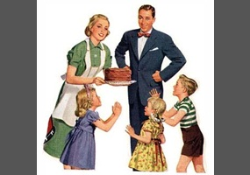
Christianity:
Christian parents raise children in Christian faith, teaching them to pray. Role of the husband to provide for the family financially and if not they are going against God. “Anyone that does not provide for their family is worse than an unbeliever.’’ (Bible.)​
Extended families – customs and traditions were passed to the next generation and helped strengthen the religious bond.
Islam:
Muslim parents bring up children in Islamic faith by teaching them halal and haram. Help children find suitable marriage partner and read the Quran. A Muslim mother commands great respect and obedience from her children as she looks after the household and raises the children = holds significance in Islam. “Heaven is under the feet of the mothers.” (Quran)
Extended family – basis of Islamic society, part of God’s plan for humanity.
The role of men and women

Slide 13

The role of children
Christianity: Christianity teaches to obey, love and respect your parents and honour them by taking care of them when they are older or in need of support. “Listen to your father, who gave you life, and do not despise your mother when she is old.” (Bible)
Children are gifts from God so parents must respect their dignity. The family reflects Christ’s relationship with the Church.
Islam: Children have a duty to respect their parents, even in adulthood. To be unkind or disrespectful towards your parents is a great sin. “He who is good to his parents, blessing be upon him…” (Hadith)
Children are a blessing from God and parents have a duty to provide a stable environment and raise children to be good Muslims.
Most Muslims would not consider putting parents in a care home but value their wisdom and experience and feel honoured to repay them for their love and support in life.

Slide 14
Gender Equality
There is equality | There isn't equality
'It is he who created you from a single person.' (Qur'an) | Adam made in the image from God, Eve made from his rib.
Men and women expected to do the same Five Pillars. 'Pilgrimage to the House is a duty...' (Qur'an) | Catholic priests are all male – Jesus as 12 male disciples, 'take this in remembrance of me.' (Bible)
'Heaven lies under the feet of one's mother.' (Hadith) | Males attend Jummah prayer - 'hurry towards the reminder of God and leave off your trading.' (Qur'an)
'There is no male nor female, for you are all one in Christ.' (Bible) | Traditionally men have worked, woman look after children. 'Wives, submit to your husbands.'(Bible)
Libby Lane first female bishop in the CofE – she hands out the Eucharist. | Saint Paul, 'a woman should remain silent in the Church.' (Bible)
Jesus loved everyone equally. He healed a bleeding woman. 'All people are created in the image of God.' (Bible) | Polygamy and divorce differences in Islam. 'Marry the women who seem good to you, two, three, four..' (Qur'an)

Slide 15
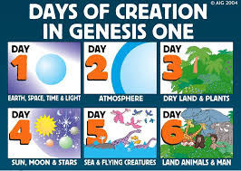
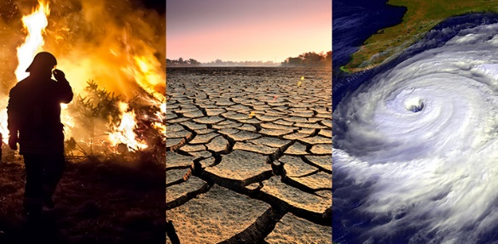
Theme B: Religion and Life
Origins of creation:
The environment:
Vivisection:
Cosmetic testing:
Origins of human life:
Abortion:
Euthanasia:
Life after death:
To be able to revise the section Religion and Life and understand how to answer exam questions.

Slide 16
Origins of Creation
Christianity
Fundamentalists (creationists) – six literal days ’24 hour periods of creation (Genesis = literal.) God created everything in six days and rested on the seventh day. Don’t accept the Big Bang theory.
‘’Your Lord is God who created the heavens and the Earth in six days.’’ (Genesis)
Liberals – Six days = longer period of time. Can accept the Big Bang as part of God’s plan.
(Genesis = symbolic)
To be able to revise the section Religion and Life and understand how to answer exam questions.

Slide 17
Origins of Creation
Islam
Six days = six periods of time. No reference in the Qur’an as to what was created each day. Heaven and Earth split in two smoke-like forms by Allah. Sounds similar to the conditions of the Big Bang. Can accept the Big Bang as part of Allah’s plan.
Science
Expansion of time and space over 13.8 billion years (Big Bang.) Evidence - Red Shift and CMBR.
To be able to revise the section Religion and Life and understand how to answer exam questions.

Slide 18
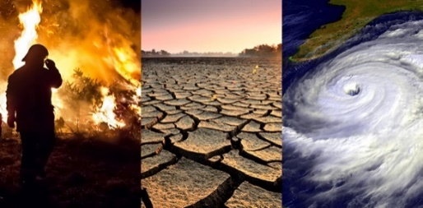
The
Environment
There are numerous problems facing the environment; including deforestation, climate change and plastic pollution.
Christianity
Christians should behave as stewards and are responsible to care and protect the world that God created. Adam was told to look after it, ‘’The Lord God took the man (Adam) and put him in the Garden of Eden to work and care of it.’’ (Bible)
Although a minority of Christians take the approach of dominion, that they can use the environment for their own use as they choose, e.g. Trump encouraging the use of fossil fuels. This is because the Bible also says that Adam was told to ‘’rule over the fish in the sea and the birds in the sky.’’ (Bible)
However, this approach of dominion causes environmental damage and can lead to the destruction of habitats and the extinction of animals.

Slide 19
The Environment
Islam
Muslims should act as khalifah (stewards) and protect what Allah has created. They will be judged on how they have fulfilled this role. They don’t promote dominion.
‘’Do not seek from it more than you need.’’ (Hadith)
To be able to revise the section Religion and Life and understand how to answer exam questions.

Slide 20

Solutions
Christianity
Christians promote the 3 R’s as part of stewardship – reduce, reuse and recycle in order to reduce the use of non-renewable resources such as coal, oil and gas and move towards renewable resources, such as wind, sea and solar.
They encourage sustainable development – develop with the use of recycled resources such as recycled wood and renewable energy.
Reduce – food waste, plastic waste etc.
Reuse – bags, clothes etc.
Recycle – bottles, cans etc.
‘’The Lord God took the man (Adam) and put him in the Garden of Eden to work and care of it.’’ (Genesis)
To be able to revise the section Religion and Life and understand how to answer exam questions.

Slide 21
Solutions
Islam
The planet is only on loan and should be given back as Muslims found it. They promote the 3 R’s and living simply like the Prophet Muhammad demonstrated.
‘’Do not seek from it more than you need.’’ (Hadith)
‘’Eat and drink (as we have permitted) but do not be extravagant.’’ (Qur’an)
To be able to revise the section Religion and Life and understand how to answer exam questions.

Slide 22
Animals
Christianity
Some eat meat in line with God’s command to Noah after the flood, whilst others are vegan/vegetarian for ethical reasons – i.e. slaughter is cruel.
Pro-meat: ‘’Everything that lives and moves will be food for you.’’ (Bible)
Anti-meat: ‘’The righteous care for the needs of their animals.’’ (Bible)
But they shouldn’t judge one another. ‘’The one who eats everything (meat) must not treat with contempt the one who does not...’’ (Bible)
Some Christians accept vivisection (medical) to find cures to diseases, others say it is cruel and unreliable. 3R’s – reduce, refine, replace.
Pro-vivisection: ‘’rule over the fish in the sea and the birds in the sky.’’ (Bible)
Anti-vivisection: ‘’The righteous care for the needs of their animals.’’ (Bible)
No acceptance of non-essential cosmetic testing (for shampoos, soaps, makeup etc.)

Slide 23
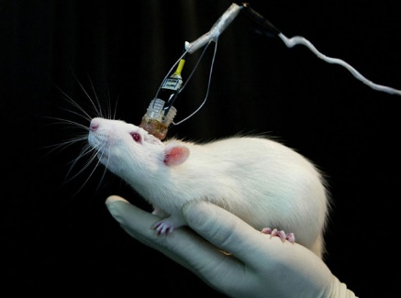
Animals
Islam
Only halal meat is eaten (Sharia law.) ‘’It is God who provides livestock for you.’’ (Qur’an)
Only essential testing is allowed – vivisection is essential to save lives, cosmetic is not.
‘’Whoever kills a sparrow or anything bigger than that without a just cause..’ (Hadith)

Slide 24
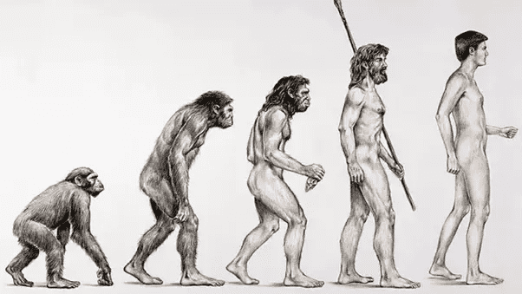
Origins of Human Life
Christianity
Fundamentalists – Adam was created in God’s image – 6th day of creation. God made him from the soil. ‘’And the Lord God formed man of the dust of the ground.’’ (Bible)
Eve created from Adam’s rib. Fundamentalists do not accept evolution.
Liberals – Evolution is God’s plan for humanity, he started it off and oversees it. Man did evolve from other animals.
To be able to revise the section Religion and Life and understand how to answer exam questions.

Slide 25
Origins of Human Life
Islam
Adam is the first man and prophet, moulded from clay. Hawwa is his wife made from the same soul. ‘’You humans were lifeless and He have you life.’’ (Qur’an)
Some Muslims accept animal evolution but not human evolution. Adam was inserted into the process.
Science
Humans and animals evolved from a common ancestor through natural selection. Charles Darwin’s theory. Evidence – DNA and fossil record.
To be able to revise the section Religion and Life and understand how to answer exam questions.

Slide 26
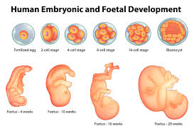
Abortion
Abortion is the termination of a foetus. UK law – before 24 weeks.
Christianity:
Pro-life: Life of foetus is equal to mothers. Sanctity of the life of the foetus/it was made in God’s image and should be protected. ‘’For you created my inmost being; you knit me together in my mother’s womb.’’ (Bible)
Pro-choice: Choice of the mother is more important than the life of foetus. Abortion of the lesser of two evils. In the cases of rape or severe disability abortion is the less evil option. ‘’Clothe yourself with compassion.’’ (Bible)
To be able to revise the section Religion and Life and understand how to answer exam questions.

Slide 27
Abortion
Islam:
Abortion is generally haram; however, is permitted if there will severe mental/physical disabilities of foetus or to save mother’s life. Some Muslims accept abortion in the case of rape. Abortion must happen before ensoulment. Contrasting views – 40 days vs 120 days.
Abortion is never accepted in the case of financial difficulties. ‘’Do not kill your children for fear of poverty – We shall provide for them and you.’’ (Qur’an)
To be able to revise the section Religion and Life and understand how to answer exam questions.

Slide 28

Euthanasia refers to the merciful ending of the life of someone in severe pain or terminally ill, e.g. Daniel James. Legal in the Netherlands and Switzerland but not the UK (14 year prison sentence for aiding.)
Christianity
RC – Oppose euthanasia due to the sanctity of life argument and the idea everyone was created in the image of God. ‘’So God created mankind in his own image.’’ (Bible) Also, Jesus put up with his suffering so we should too – resilience.
CofE – Generally more accepting due to the lesser of two evils argument in the case of terminal illness and severe pain and the argument from freewill.
Apply agape - ‘’love your neighbour as yourself.’’ (Bible)
Euthanasia
To be able to revise the section Religion and Life and understand how to answer exam questions.

Slide 29

Euthanasia
Islam
Euthanasia is haram and against the sanctity of life of a person. Undermines Al-Qadr (predestination) as prematurely ends a life that God had a plan for. ‘’No soul may die except with God’s permission at a predestined time.’’ (Qur’an)
Suffering could be part of God’s plan for us (a test) which we shouldn’t question.
To be able to revise the section Religion and Life and understand how to answer exam questions.

Slide 30

Christianity
Heaven is a reward, described as a peaceful place with no pain or suffering; where God will ‘’wipe every tear from their eyes.’’ (Bible) Whereas hell is a punishment for wrongdoers. Some Christians see it as a place of eternally burning flames and torment, whereas others see it as a darkness without the light of God.
Roman Catholics discuss purgatory; a place where the soul waits until it is cleansed enough to enter heaven.
Christians are influenced by the prospect of an afterlife to act like a ‘sheep’ in the parable of the Sheep and Goats, giving food and drink to the poor. ‘’For I was hungry and you gave me something to eat.’’ (Bible)
Life after Death

Slide 31
Islam
The term for life after death is Akhirah. Muslims say this life is temporary and a test for the afterlife. There are seven levels of heaven in Islam described as ‘’the Garden of Gardens’’ (Qur’an) and one hell where sinners are said to ‘’dwell amid scorching wind and scalding water in the shadow of black smoke, neither cool nor refreshing.’’ (Qur’an)
Judgement happens after the al-Mahdi returns and Izraf’il blows the trumpet.
Life after Death
To be able to revise the section Religion and Life and understand how to answer exam questions.

Slide 32
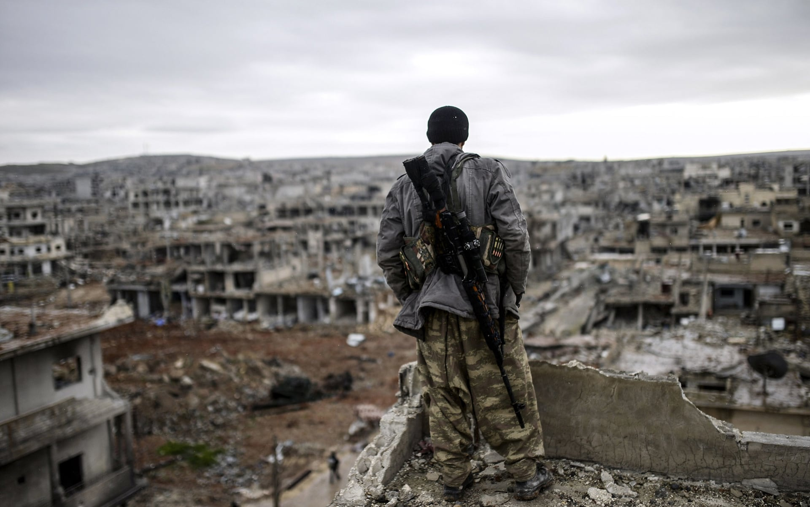
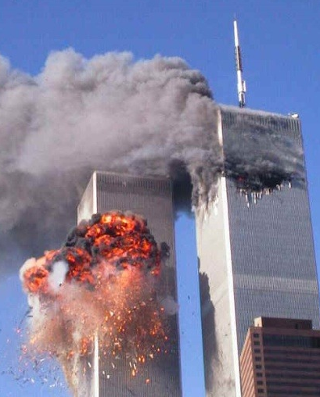

Topic C: Religion, Peace and Conflict
Key principles
Reasons for war
Terrorism and violent protest
Weapons of mass destruction
Just war theory
Pacifism
Responses to victims of war
Arguments for and against war
To be able to revise the section Religion, peace and conflict and understand how to answer exam questions.

Slide 33
 | Definition | Importance in Christianity | Importance in Islam
Justice | Bringing about what is right and fair or making up for a wrong. | Jesus explains that God’s judgement is just in the Parable of the Sheep and Goats. Just War Theory – war can only take place if it is just and aimed at bringing about good. | Adalat is one of the five roots of Shia Islam. Muhammed/Saladin was just, both did not kill prisoners but spared their lives.
Forgiveness | Showing grace and mercy and pardoning someone for their wrongs. | “Forgive not seven times but seven times seventy.” (Bible) Jesus offers unlimited forgiveness. | ''Let them pardon and forgive.” (Qur'an) Allah forgave Adam on Mount Arafat
Reconciliation | Restoring friendly relations after disagreement or conflict | Jesus atoned on the cross to reconcile man and God. “Forgive not seven times but seven times seventy.” (Bible) ''Forgive them Father for they know not what they do.'' (Bible) | ''If the enemy is inclined towards peace, make peace with them.'' (Quran) Rules of Lesser Jihad – allow for peace if the enemy surrenders.

Slide 34

Reasons for war
Reason for war | Example | Relevant quotes
Greed – war is used to take the natural resources or land of another country | Many people think the Iraq war (1990) occurred as Iraq wanted to secure the oil reserves if Kuwait. | Christianity: “The love of money is a root of all kinds of evil.” (Bible) Islam: “God does not like arrogant, boastful people.” (Qur'an)
Retaliation – some countries go to war after their citizens have been harmed so that the attackers get ‘pay back’ | After the 9/11 terrorist attacks, the USA invaded Afghanistan, looking to catch Bin Laden who masterminded the 9/11 attacks. | Christianity: “Do not repay anyone evil for evil.” (Bible) Islam: Rules of lesser Jihad - only fighting in self-defence and the response should be proportionate.
Self-defence – Countries may go to war with an aggressor to protect their land, citizens and way of life | Great Britain fought in WWII to protect themselves against Nazi invasion which was a threat to the democratic ideals of Western Europe. | Christianity: “If anyone slaps you on the right cheek, turn to them the other cheek.” (Bible) Islam: “Those who have been attacked are permitted to take up arms.” (Qur'an)
Ethnic hatred – Sometimes, people of different ethnic backgrounds will go to war due to longstanding disputes over ethnic or cultural differences | Israel/Palestine, Iraq civil war. | 'Love one another and I have loved you.' (Christianity) 'It is he who created you from a single person.' (Qur'an)
To be able to revise the section Religion, peace and conflict and understand how to answer exam questions.

Slide 35
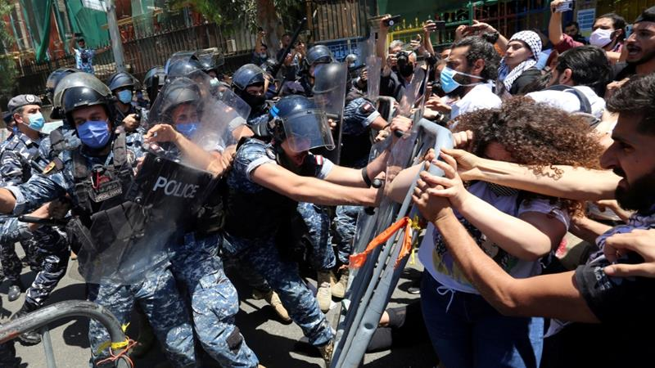
Terrorism and violent protest - Christianity
Terrorism – The unlawful use of violence, usually against civilians to achieve a political goal, e.g. suicide bombing.
Christians are against terrorism because of the sanctity of life, the principle of agape (“love thy neighbour”) and the fact that many liberal Christians such as Quakers are pacifists.
Violent protest – Expressing disapproval by using actions that threaten or harm others, e.g. rioting.
Christians are generally against violent protest because of the principle of agape and the fact that liberal Christians are pacifists (e.g. the example of Martin Luther King who protested peacefully for civil liberties). Anglican Pacifist Fellowship - boycotts and negotiations.
To be able to revise the section Religion, peace and conflict and understand how to answer exam questions.

Slide 36
Terrorism and violent protest - Islam
Terrorism – The unlawful use of violence, usually against civilians to achieve a political goal, e.g. suicide bombing.
Muslims are against terrorism as Islam is a religion of peace. 'It is he who created you from a single person.' (Qur'an) The principle of the sanctity of life can be used to argue against terrorism, as can the rules of Lesser Jihad – do not kill an innocent man, woman or child.
Violent protest – Expressing disapproval by using actions that threaten or harm others, e.g. rioting.
Generally opposed in Islam – rioting can lead to people getting hurt. Lesser Jihad – no not kill innocent men, women or children.
To be able to revise the section Religion, peace and conflict and understand how to answer exam questions.

Slide 37
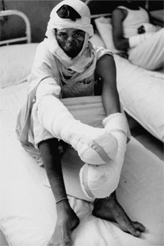
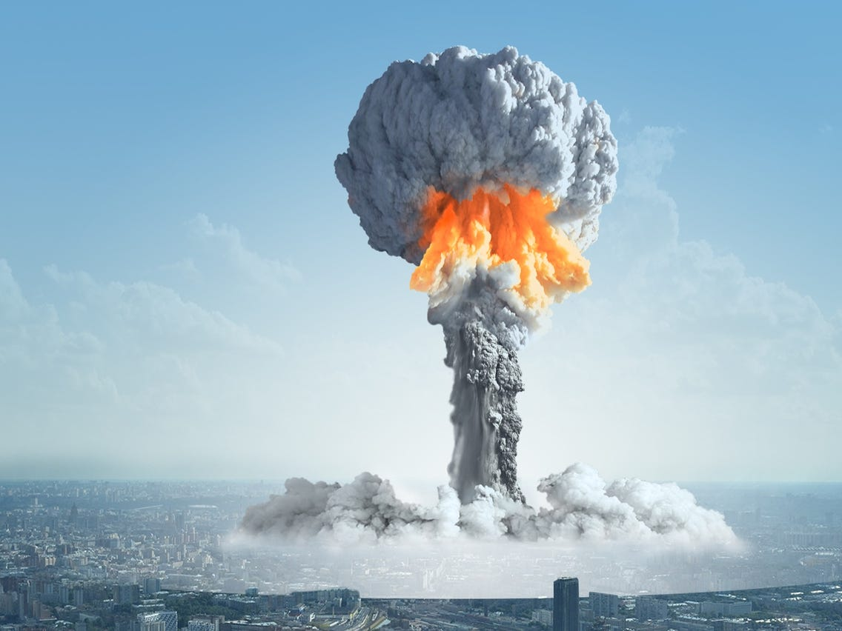
Weapons of mass destruction
Weapons of mass destruction – weapons that can kill large numbers of people and / or cause great damage.
Nuclear weapons – weapons that use a nuclear reaction; they devastate large areas and kill large numbers of people. E.g. used to end WWII when America dropped them on Japan.
Biological weapons – weapons that use living organisms or infected materials that lead to disease or death.
Chemical weapons – weapons that use chemicals to poison, burn or paralyse humans and destroy the natural environment. E.G. America dropped napalm during the Vietnam War.
Arguments for weapons of mass destruction
Deterrent – If countries have weapons of mass destruction they are less likely to be attacked.
The only time that nuclear weapons have been used (by America on Japan), they ended WWII. There has not been a world war since then.
**Many people believe that it is acceptable to possess weapons of mass destruction as a deterrent to prevent war, however their use would not be acceptable.
Arguments against weapons of mass destruction
*Sanctity of life – Christianity and Islam
*Just war theory (weapons must be proportionate and innocent civilians not harmed) – Christianity and Islam
*Stewardship – Christianity and Islam
*Pacifism – Christianity
*Agape – Christianity
*Qur’an - “Fight in God’s cause... but do not overstep the limits.”

Slide 38
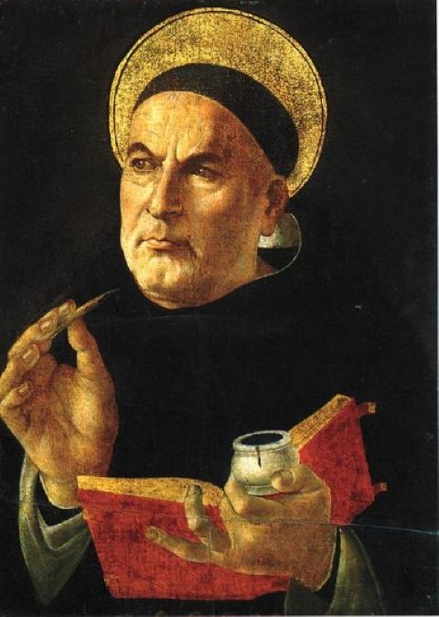
Just war theory - Christianity
All of the following conditions must be met for a war to be just...
The war must have a just cause, e.g. self-defence. | jus ad bellum (fought for the right reasons)
The war must be declared by a valid authority, e.g. government
The intention of the war must be to promote good and defeat wrongdoing.
The war must be a last resort, e.g. diplomacy must have been exhausted.
There must be reasonable chance of success. | jus in bello (fought under the right conditions
The methods used to fight the war must be proportional, e.g. no nuclear weapons.
The war must be fought by just means, e.g. civilians are not targeted.
Just war theory was established by Saint Thomas Aquinas.
It provides rules as to when and how a war can be fought to ensure it is ethical.
To be able to revise the section Religion, peace and conflict and understand how to answer exam questions.

Slide 39
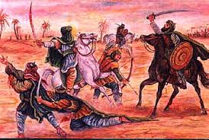
Just war theory - Islam
Islamic scholars and leaders agree that the following conditions must all be met if a war is to be just:
*It is fought for a just cause, e.g. to defend Islam.
*It is a last resort.
*It is authorised by a valid Muslim authority.
*It is done in self-defence – “Fight for the cause of God those that fight you...” (Qur’an)
*The minimum amount of suffering is caused.
*War ends when the enemy surrender.
*Innocent civilians are not attacked.
*The aim is to restore peace and freedom.
Abu Bakr was responsible for devising some of the rules that Muslim armies must obey to govern their conduct during a war (similar to jus in bello)
Referred to as Lesser jihad meaning to defend Islam from threat
“To anyone who fights in God’s way... We shall give a great reward” (Qur’an).
To be able to revise the section Religion, peace and conflict and understand how to answer exam questions.

Slide 40
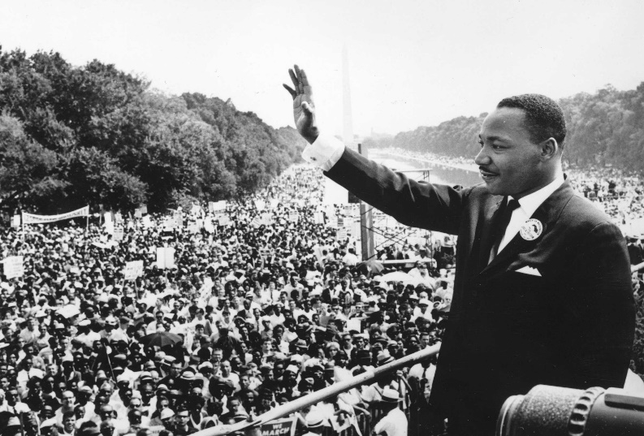
Pacifism - Christianity
Pacifism – the belief that war and violence are wrong.
Conscientious objector – people who refuse to take part in war / perform military service as they believe violence is wrong.
Many of Jesus’ teachings support pacifism:
*“Blessed are the peacemakers.”
*“Love your enemies, bless those who curse you.”
*”Forgive not seven times, but seven times seventy times”, i.e. if someone harms you, you should forgive them rather than seek retribution.
*Jesus’ teaching of agape is also applicable. We do not want to be harmed ourselves, so the teaching “treat others as you want to be treated” supports pacifism.
The Quakers base their ideology upon agape and they are therefore commonly pacifists – they believe that everyone has ‘the light of Christ within them’ and therefore should not be harmed.
*During WWII, many Quakers were conscientious objectors.
*Instead of fighting, they undertook ‘work of national importance’ such as farming, taking care of the sick, driving ambulances or fighting fires.
Martin Luther King was a Baptist minister. As a Christian leader, he promoted non-violent protest in order to gain civil rights for black Americans. He never condoned the use of violence, even though he and his followers were treated unjustly and violence was aimed towards them.
To be able to revise the section Religion, peace and conflict and understand how to answer exam questions.

Slide 41

Pacifism - Islam
Pacifism – the belief that war and violence are wrong.
Conscientious objector – people who refuse to take part in war / perform military service as they believe violence is wrong.
Although Islam is a religion of peace, it is difficult for Muslims to commit to a pacifist ideology as they are bound by the duty of lesser jihad, the example of the prophet who participated in war and instructions to fight in the Qur’an such as:
*”Fighting has been ordained for you”
However, there are also Islamic teachings that suggest that violence should be avoided and can therefore be used to argue in favour of a pacifist approach:
* ”Control your anger, forgive your brother” (Hadith)
*”If they incline towards peace, make peace with them” (Qur’an)
*“None of you truly believe until he wishes for his brothers what he wishes for himself” (Hadith)
*”Paradise is for those who curb their anger and forgive their fellow man”. (Qur’an)
There are Islamic organisations such as the Muslim Peace Fellowship (MPF) who promote the theory and practice of non-violence. They do this by:
*Understand and teach Islamic teachings about peace and non-violence.
*Aim to develop just societies to reduce the need for violence and aggression
To be able to revise the section Religion, peace and conflict and understand how to answer exam questions.

Slide 42
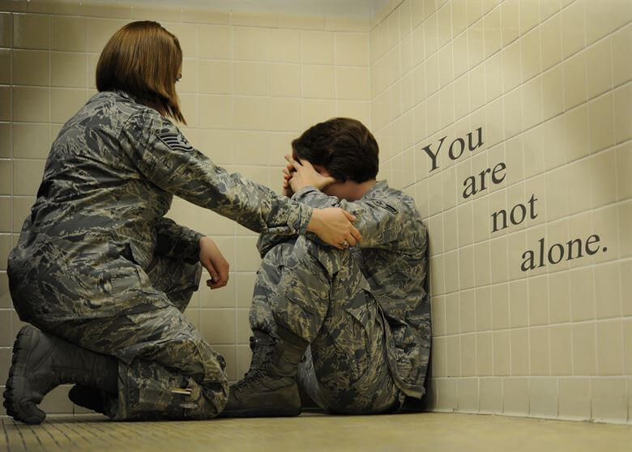
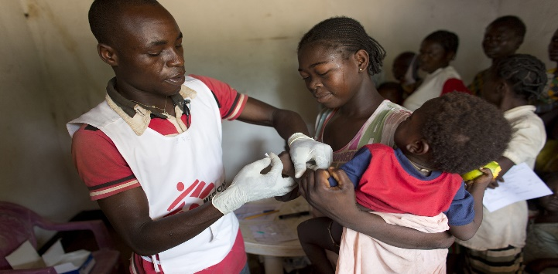
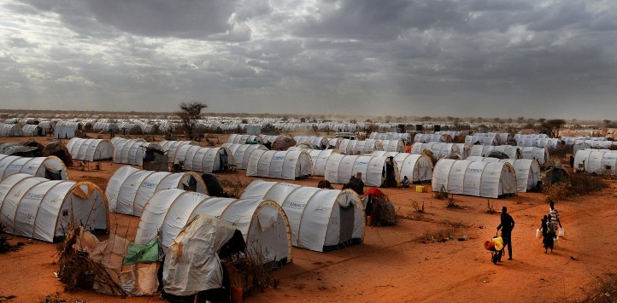
Responses to victims of war – examples of the help and support required
*Injured soldiers may need psychological support, medical help for injuries and a way of earning a living
*Civilians living in a war zone may need medical help for injuries and a way of earning a living.
*Family members whose loved ones are killed may need money to live on if the main wage earner is killed.
*Refugees who have lost their homes and livelihoods due to war may need a safe place to live and access to food and clean water.
To be able to revise the section Religion, peace and conflict and understand how to answer exam questions.

Slide 43

Responses to victims of war – Christianity
Due to the teachings of Jesus, Christians believe that they have a responsibility to help people in need, including the victims of war:
*Parable of the Sheep and Goats – all people in need should be helped and cared for.
*Agape: “love thy neighbour”; “treat others as you want to be treated.” (Bible)
*”Blessed are the merciful.” (Bible)
Christian Aid
Christian Aid are a large Christian organisation that support local charities in areas where there are people who have been impacted by war, for example, they do the following in Israel and its occupied territories:
*Lobby the Israeli government to protect human rights for everyone in Israel.
* Witness life under Israeli occupation and stand up against human rights abuses.
* Provide education and skill development to women in occupied Israeli territory so that they can earn money and support themselves.
*Support and promote the legal rights of Palestinian Arab citizens of Israel who often live in villages that are unrecognised by Israel.
To be able to revise the section Religion, peace and conflict and understand how to answer exam questions.

Slide 44

Responses to victims of war – Islam
The Qur’an, Hadith and sunnah al gives reasons that Muslims should support victims of war:
Qur’an: “Whoever saved a life, it is as if they saved the whole of mankind.” (Qur'an)
The prophet treated his prisoners of war with respect and protected their lives following the Battle of Badr.
Muslim Aid - https://www.youtube.com/watch?v=NfApFEDTtzE
Muslim Aid is an Islamic charity that uses zakat donations to help the victims of war.
*Muslim Aid established the Beity orphanage in Turkey to support orphans whose parents were killed in the conflict in Syria. The orphans are kept safe, fed, clothed, receive healthcare and are educated by using Muslim Aid funds.
*Helping refugees effected by the Syrian conflict on the Syrian-Jordan border by establishing medical camps so that refugees can receive free medical treatment. Muslim Aid also distribute food, blankets and bedding to the refugees.
To be able to revise the section Religion, peace and conflict and understand how to answer exam questions.

Slide 45
Reasons for and against war
- Christianity
In order to successfully answer a question either ‘for’ or ‘against’ war, you should utilise the knowledge that you have from the whole of the Religion, peace and conflict module.
Reasons for war
*The Just War Theory of Thomas Aquinas allows war in certain circumstances – self-defence.
*The book of Exodus teaches: “An eye for an eye, a tooth for a tooth”; this suggests that war is acceptable as retaliation.
Reasons against war
*The sanctity of life – all people are made “in the image of God” and The Ten Commandments teach “do not kill”. (Bible)
*Jesus is seen as a PACIFIST and taught: “Love your enemies” and “blessed are the peacemakers” Jesus also stopped his disciples using violence saying “put your sword back into its place” when his disciples tried to prevent his arrest.
*Jesus’ teachings of agape generally suggest that war should be avoided: “love thy neighbour”. (Bible)

Slide 46
Reasons for and against war
- Islam
In order to successfully answer a question either ‘for’ or ‘against’ war, you should utilise the knowledge that you have from the whole of the Religion, peace and conflict module.
Reasons for war
*The principle of Lesser jihad
*The prophet Muhammed was involved in conflicts such as the Battle of Badr.
“Those who have been attacked are permitted to take up arms.” (Qur'an)
Reasons against war
*The sanctity of life.
*War inevitable causes destruction of the environment around us and as stewards (khalifahs) of God’s creation, we should do all that we can avoid such destruction of the planet.
*On the Day of Judgement Allah will show mercy and forgiveness to those who have shown mercy and forgiveness to others.
From the Qur’an:
*”If they incline to peace, make peace with them.” (Qur'an)
'Let them pardon and forgive.' (Qur'an)

Slide 47
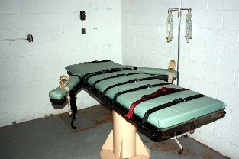
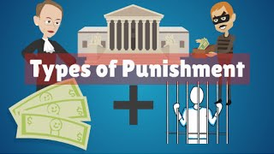
Theme D: Religion, Crime and Punishment
Capital Punishment
Forgiveness
Causes of Crime
Aims of Punishment
Types of Punishment
Hate Crimes
Evil, Suffering and Freewill
To be able to revise the section Religion, Crime and Punishment and understand how to answer exam questions.

Slide 48
Capital Punishment
Capital punishment refers to the death sentence. Currently 53 countries such as China and Iran maintain capital punishment. Examples include a lethal injection, hanging and even stoning. The death sentence was abolished in the UK in 1969.
To be able to revise the section Religion, Crime and Punishment and understand how to answer exam questions.

Slide 49
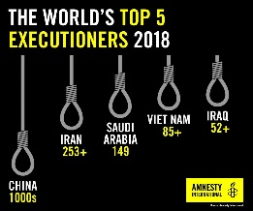
Christian and Islam Views on Capital Punishment
Advocates: Those who support the death sentence (still exists in some American states) argue that such a strict punishment is a good way to deter criminals and allow for retribution for heinous crimes. They refer to the Old Testament, ‘’an eye for an eye, a tooth for a tooth.’’ (Bible)
Opposition: Those who oppose would argue that innocent people have been wrongly accused and killed and capital punishment does not allow for reformation. Jesus taught, ‘’ forgive not seven times but seventy times seven.’’ (Bible)
To be able to revise the section Religion, Crime and Punishment and understand how to answer exam questions.

Slide 50

Christian and Islamic Teachings on Forgiveness
Advocates: Supporters argue that hudud crimes are unforgivable (as stated in the Qur’an,) e.g. drinking alcohol, drugs and apostasy and should be punished to deter others. The Qur’an teaches, ’take not life which God has made, except by way of justice and law. Thus does he command so that you may have wisdom.’’ Execution remains part of the law enforced in Saudi Arabia, Yemen, Qatar, UAE, Iran and Mauritania.
Opposition: Some Islamic countries (Pakistan) impose fines or corporal punishment instead, or alternatively accept diyya contributions as retribution. Muhammad encouraged forgiveness and some Muslims say only God should take away life. The Qur’an teaches, ‘’let them pardon and forgive. Do you not wish that God should forgive you? God is most forgiving and merciful.’’
To be able to revise the section Religion, Crime and Punishment and understand how to answer exam questions.

Slide 51
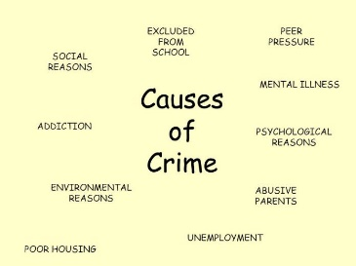
Causes of Crime
Causes:
Causes include poverty, addiction, upbringing and greed.
Responses in Christianity:
Jesus taught ‘’money is the root of all evil,’’ meaning a focus on wealth can lead to crime, e.g. fraud. He taught in the Parable of the Good Samaritan and the Parable of the Sheep and Goats that to avoid crime humans should share their wealth, ‘’for I was hungry and you gave me something to eat.’’ (Bible)
Responses in Islam:
Similarly in Islam, Muslims share their wealth by giving zakat (2.5% of their income to the poor.) The Qur’an teaches that, ‘’alms are for the poor and the needy.’’ (Qur'an)
To be able to revise the section Religion, Crime and Punishment and understand how to answer exam questions.

Slide 52
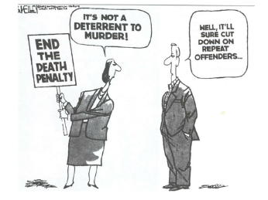
Aims of Punishment
The aims of punishment can be remembered as RDR:
Retribution – to take one's revenge on the perpetrator ‘’an eye for an eye.’’ (Old Testament) Corporal punishment and capital punishment allow for revenge and this is one of the key reasons punishment is carried out in Islam, ‘’cut the hands off thieves as a punishment for what they have done.’’ (Qur’an)
Deterrent – to prevent similar crimes being carried out in the future. Fine and jail time aim to deter other people committing similar crimes.
Reformation – to encourage criminals to show improved behaviour. Jail time (with counselling/therapy) and community service encourage opportunities for improved behaviour. ‘’Forgive not seven times but seventy times seven.’’ (New Testament) ‘’For I was in jail and you visited me.’’ (Parable of the Sheep and Goats.)
To be able to revise the section Religion, Crime and Punishment and understand how to answer exam questions.

Slide 53
Types of Punishment
The types of punishment can be remembered as PCC.
Prison – a loss of liberty imposed by the state. It is a controlled setting where all liberty including one's food and exercise is controlled. The length of a prison sentence should fit the crime committed, but critics argue prisons are overcrowded, underfunded, and full of drugs and gangs. In Islamic countries less emphasis is given on prison sentences in favour of corporal punishment.
Corporal – Involves punishments causing physical pain, i.e. lashing, beating, amputation and capital punishment. In Islamic countries there is greater emphasis placed on corporal punishments since they see this as more effective in deterring criminal behaviour, ‘’cut the hands off thieves as a punishment for what they have done.’’ (Qur’an) Many Christians say it is too violent and again the human rights of criminals. They favour prison time.
Community service – giving back through helping out in the community e.g. cleaning streets. This allows for reformation (improved behaviour) and it is preferred by many Christians; ‘’forgive not seven times but seventy times seven.’’ (NT) However, many Muslims say it is too lenient and doesn’t deter criminals.
To be able to revise the section Religion, Crime and Punishment and understand how to answer exam questions.

Slide 54
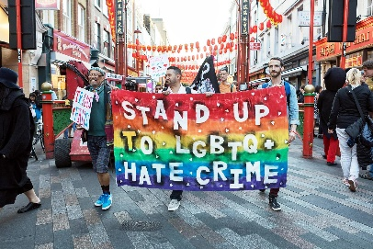
Hate Crimes
Hate crimes include crimes that are specifically against ones gender, religion, sexual orientation or nationality. E.g. beating up a lesbian couple or attacking Muslims in a mosque.
Christianity:
Example: Dylan Roofe killed nine African American Christians in Charleston (USA) in 2015 to ‘ignite a race war.’
Yet Christianity teaches of human equality. ‘'Do not murder,’’ since all life is sacred, ‘’love your neighbour as yourself,’’ and ‘’do unto others as you would have them do unto you.’’ (Bible) The Parable of the Good Samaritan teaches us to help those who we may not even have good relations with.
To be able to revise the section Religion, Crime and Punishment and understand how to answer exam questions.

Slide 55
Hate Crimes
Islam:
Example: Islamophobia – the dislike or prejudice towards Muslims such as verbal or physical abuse.
Yet Islam teaches that ‘’He created you from a single person’’ (Qur'an) and that all humans originate from the prophet Adam, so we should not act towards another human being in a way of prejudice or discrimination. The prophet Muhammad emphasized this by including Christians and Jews within the first ummah (community.)
To be able to revise the section Religion, Crime and Punishment and understand how to answer exam questions.

Slide 56
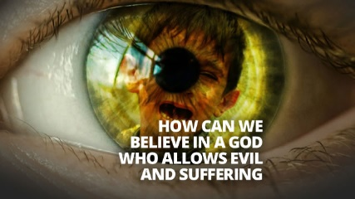
Evil, Suffering and Freewill
Moral evil refers to evil committed by humans towards another human. Some people question how and why a loving God would allow such evil things to happen (the Problem of Evil.
Christian responses to suffering:
Suffering is not always unproductive - the Bible states that suffering can produce ‘perseverance, character and hope.’ According to Christians Jesus died on the cross to rid the world of sin (atonement), so we should avoid sin to not reintroduce suffering into the world. The Parable of the Sheep and Goats explains how Christians should respond to suffering in the world, they can ‘feed the hungry, give drink to the thirsty’ etc. in order to support others overcome their suffering.
In the story of Job, he recognizes the power of God through his suffering. He loses his wife, crops and animals – but understands his place in the Universe as a result of his suffering.
To be able to revise the section Religion, Crime and Punishment and understand how to answer exam questions.

Slide 57
Evil, Suffering and Freewill
Islamic Responses to suffering:
Suffering could be a test from God. God wishes to test one's faith and obedience, e.g. Ibrahim’s test to sacrifice Ism’ail. If Muslims have caused others to suffer then they should repent, like Adam on Mount Arafat. Muslims must obey religious practices which encourage the suffering of some in the ummah to be shared with others, e.g. zakat helps shared the burden – the principle of sadaqah.
To be able to revise the section Religion, Crime and Punishment and understand how to answer exam questions.

